Slide 1

Test Software and Bootloader Development for an ECU
Electrical and Electronics Engineering Department
H. Alp Doyduk & İsmail Akbaş
Supervisor: Asst. Prof. Umut Başaran

Slide 2
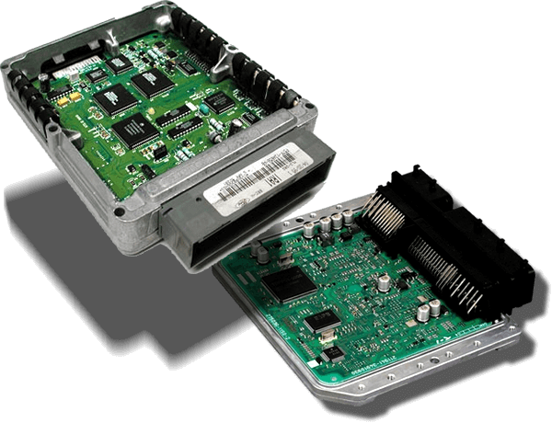
Introduction
Definition of ECUs
Specialized embedded systems in vehicles that manage electrical systems by processing inputs and executing commands using integrated hardware and software.
Importance of ECUs
ECUs manage critical operations like engine control, braking, and in-vehicle communication.
Ensure precision, safety, and efficiency in modern automotive systems.
Notes:
“Let’s begin with a brief introduction to ECUs. Electronic Control Units are specialized embedded systems in vehicles. They manage electrical subsystems by processing sensor inputs and sending control signals using both hardware and software. Their role is critical—they handle functions like engine control, braking, and communication between different parts of the vehicle. Overall, ECUs are essential for ensuring safety, precision, and efficiency in modern automotive systems.”

Slide 3
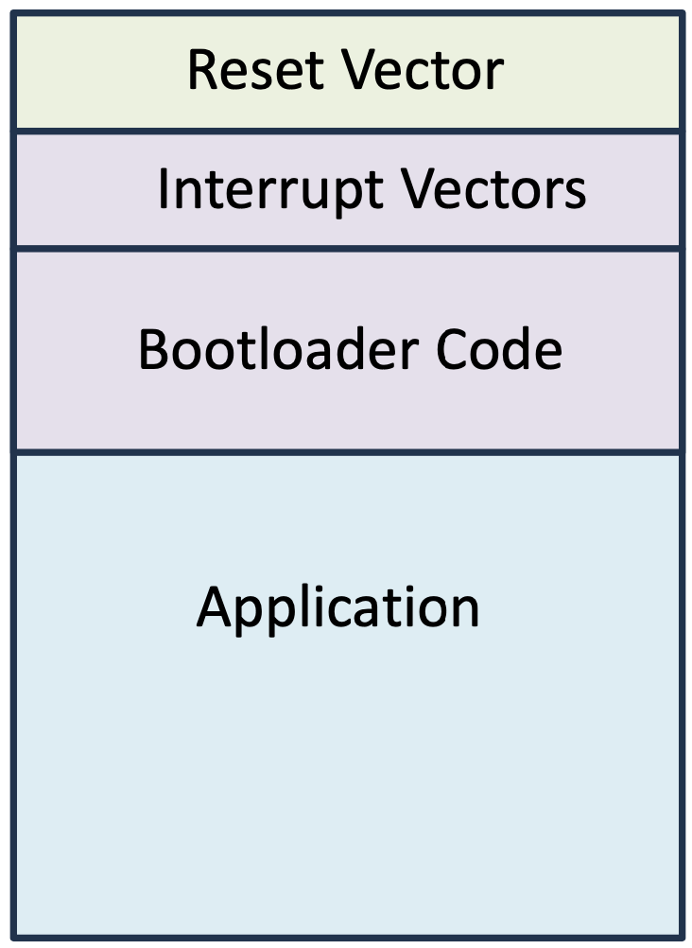
Introduction
Challenges in ECUs
ECUs are embedded inside vehicles, making physical access to programming pins impractical after deployment.
Increasing complexity requires innovative testing methods.
Solution: Bootloader and Innovative Test Software
The bootloader enables in-field firmware updates without requiring physical access to programming pins, utilizing communication protocols.
Innovative Test Software simulates real-world scenarios and edge cases, enabling automated testing and validation of ECU functions without removing them from the vehicle.
Notes:
“Once ECUs are placed inside a vehicle, accessing their programming pins becomes difficult or even impossible. Additionally, as ECUs grow more complex, traditional testing methods are no longer sufficient. Our solution is to use a bootloader that allows firmware updates over UART without physical access. Alongside that, we developed innovative test software that simulates real-world scenarios, enabling automated validation of ECU functions while the device remains installed in the vehicle.”

Slide 4
Introduction
The Aim of the Project
Design and implement a robust bootloader for updating ECU firmware using a serial communication protocol.
The bootloader must enable secure and efficient firmware updates and prevent memory corruption.
Develop a comprehensive software testing framework to ensure functionality and reliability.
The testing system should verifies the bootloader’s functionality, reliability and security under various conditions.
Notes:
“The goal of our project is to design and implement a reliable bootloader that allows ECU firmware updates over a serial interface, without needing external tools. The bootloader must ensure both security and memory protection during the update. Additionally, we aimed to create a comprehensive test software that simulates different scenarios to verify the bootloader’s correctness, robustness, and performance under various conditions.”

Slide 5



Methodology
Design Applications and Tools
KiCad for circuit design and PCB layout.
MATLAB Simulink for C code generation from block models.
MPLAB X IDE for C code firmware development and implementation on the microcontroller.

Slide 6
Methodology
Hardware Development
Component Selection (EE401)
Circuit Schematics (EE401)
Footprint Capture (EE401)
PCB Layout (EE402)
Software Development
Simulink Model (EE402)
UART Communication (EE402)
Bootloader Implementation (EE402)

Slide 7
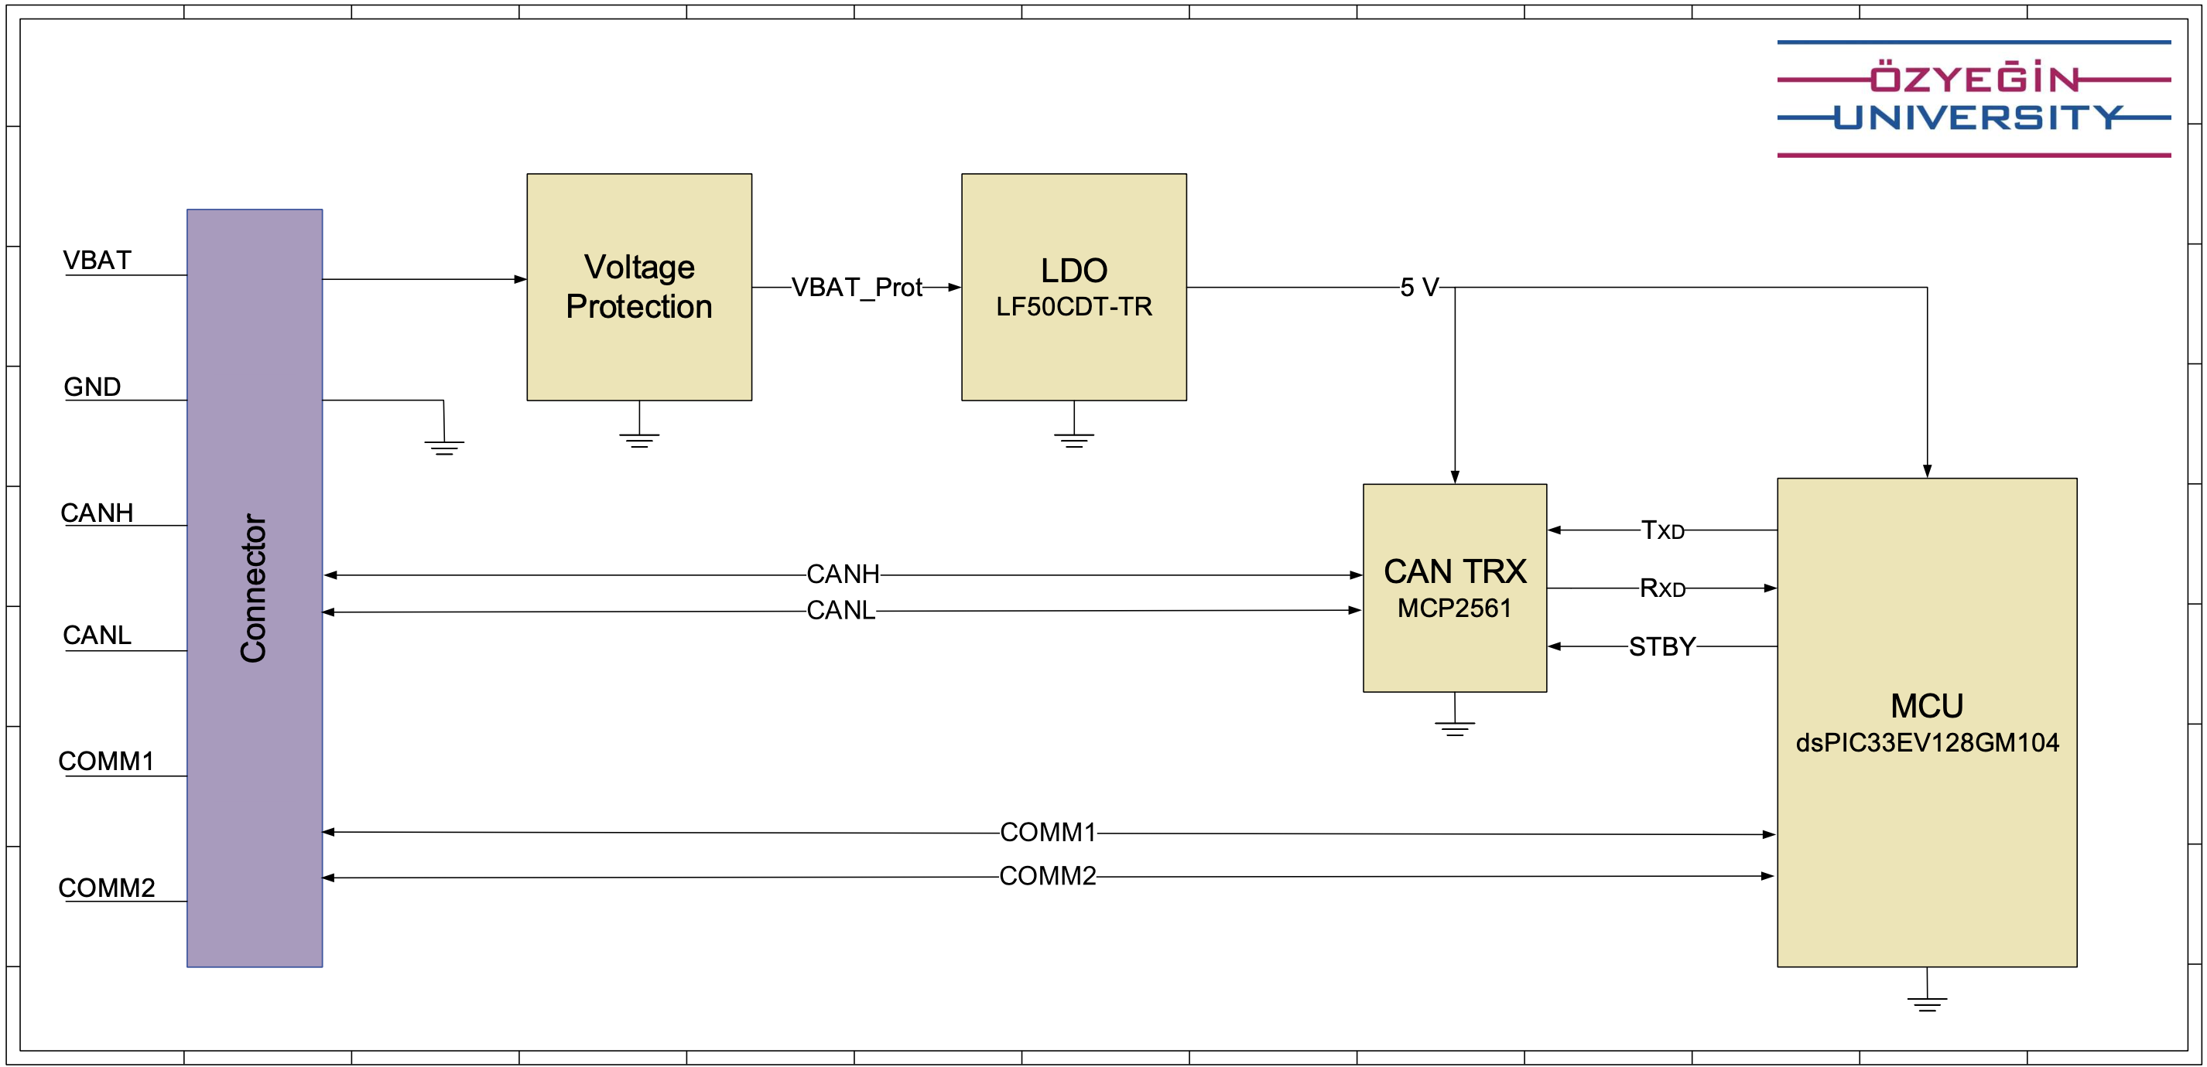
Hardware Development
Architecture Block Diagram
Notes:
Let’s move to the hardware development part. We created an architecture block diagram to provide a clear overview of this section. This block diagram shows all hardware components and basic connections between them. Our next step is choosing components.

Slide 8
Component Selection
Preliminary Specifications
Battery voltage range: 9 to 16 V
Operating temperature: -40 to 85 °C
All components are automotive-qualified and comply with AEC-Q standards
Communication interfaces: Serial port and CAN
Selected Components
LDO: LF50CDT-TR
CAN Transceiver: MCP2561
MCU: dsPIC33EV128GM104
Schottky: SS8PH10HM3-A/H
TVS: SMAJ36CA-HT
Connector: TSM-106-01-T-DV
Notes:
We selected our components to meet automotive requirements. During our research on automotive electronics, we found that the standard battery voltage is 12 volts, but it can vary between 9 and 16 volts. The operating temperature range for automotive electronics is -40°C to 85°C. Also, all components were required to comply with AEC-Q standards, which ensure a certain level of automotive-grade quality and reliability. And also, we chose components that support serial or CAN communication protocols.

Slide 9
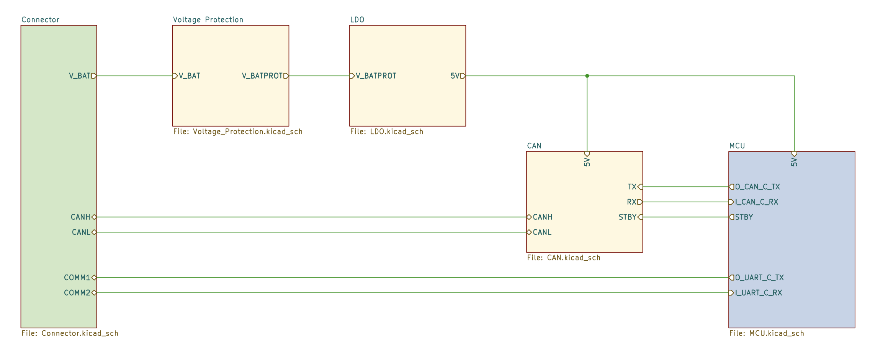
Circuit Schematics
Root Schematic
Notes:
As you can see in the Figure, we created a hierarchical schematic structure to simplify the system view in KiCad. This root schematic shows the main block connections. Battery input enters from the connector on the left, passes through voltage protection, and it is regulated to 5V by the LDO. This regulated power goes to the CAN transceiver and the MCU. UART and CAN traces connect the MCU to external systems. I will explain each of these blocks.

Slide 10
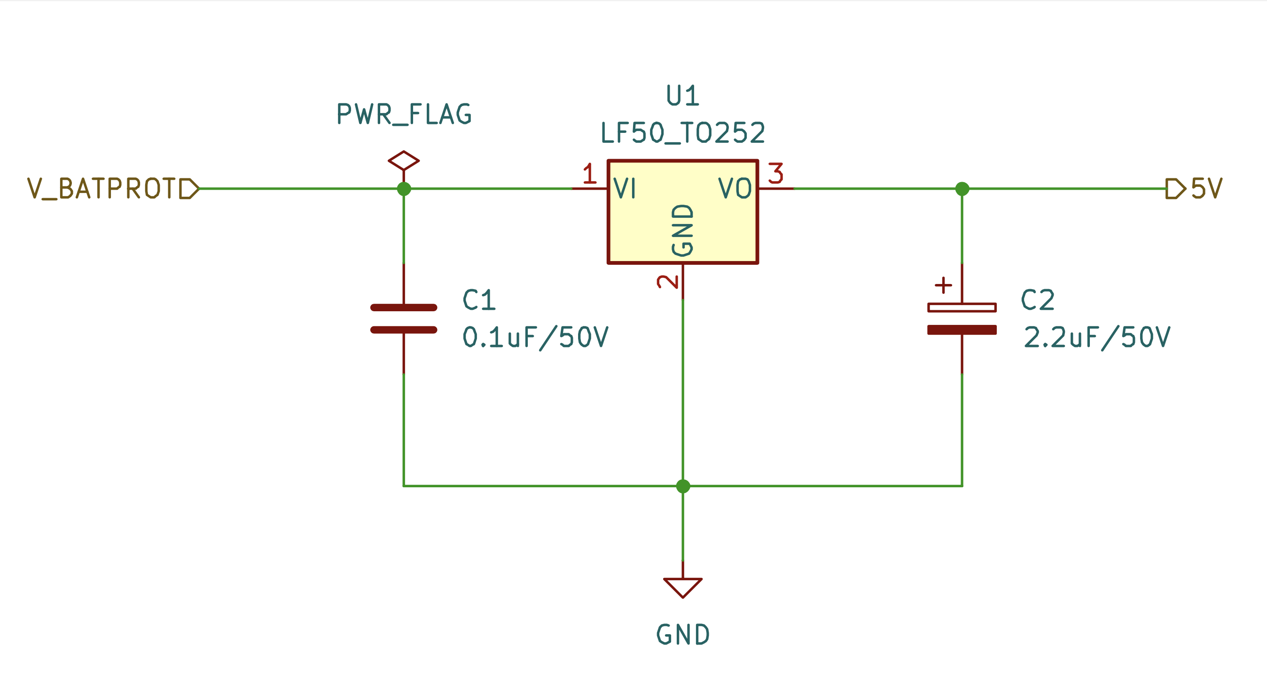
Circuit Schematics: LDO
LF50
Notes:
This is the LDO circuit using LF50 LDO. It converts the protected battery voltage into a stable 5V output. We placed input and output capacitors as recommended in the datasheet to get voltage stability.

Slide 11
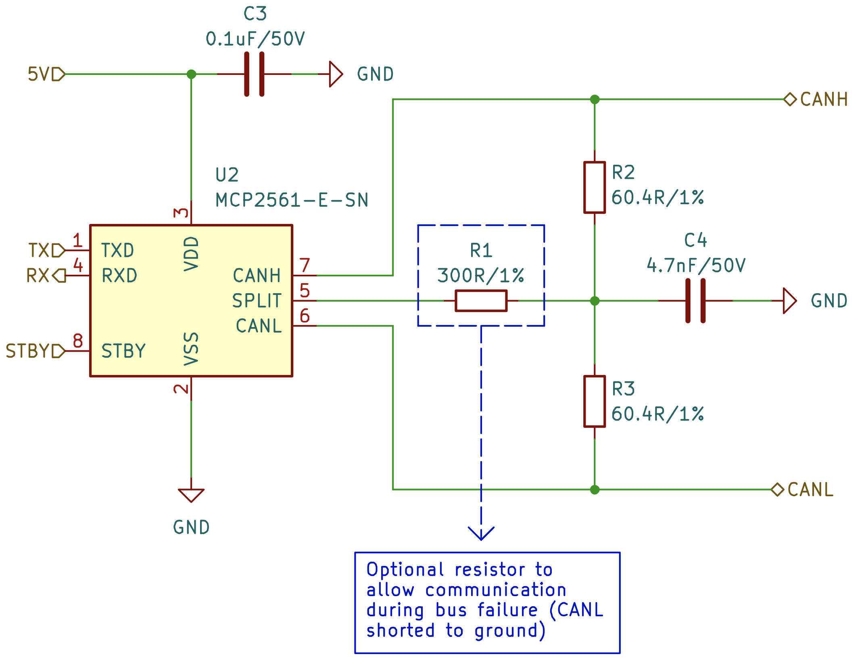
Circuit Schematics: CAN Transciever
MCP2561
Notes:
This is the circuit schematic of the MCP2561 CAN transceiver. It enables CAN communication between the MCU and external devices. We added these resistors to improve signal integrity.

Slide 12
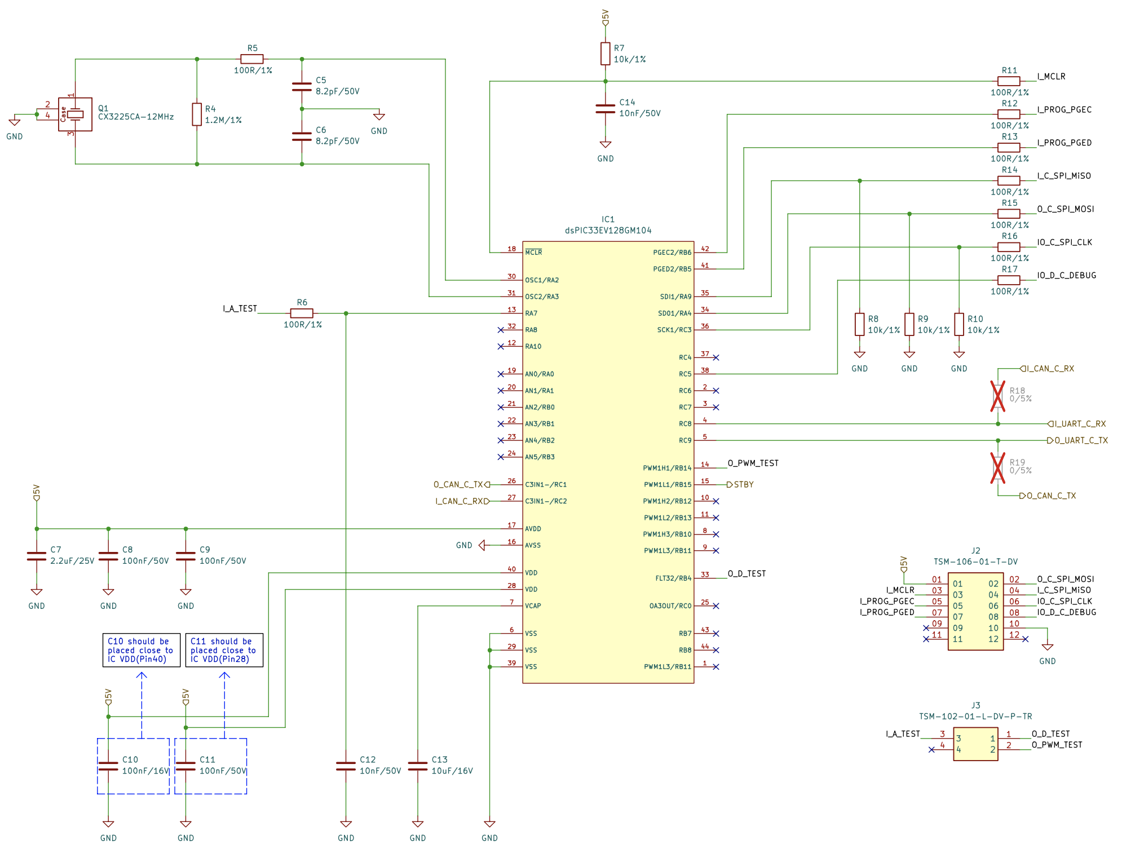
Circuit Schematics: MCU
dsPIC33EV128GM104
Notes:
This is the schematic of our microcontroller, the dsPIC33. We connected all power, reset, and programming pins. Also, we connected the UART and CAN communication pins through remappable peripherals.

Slide 13
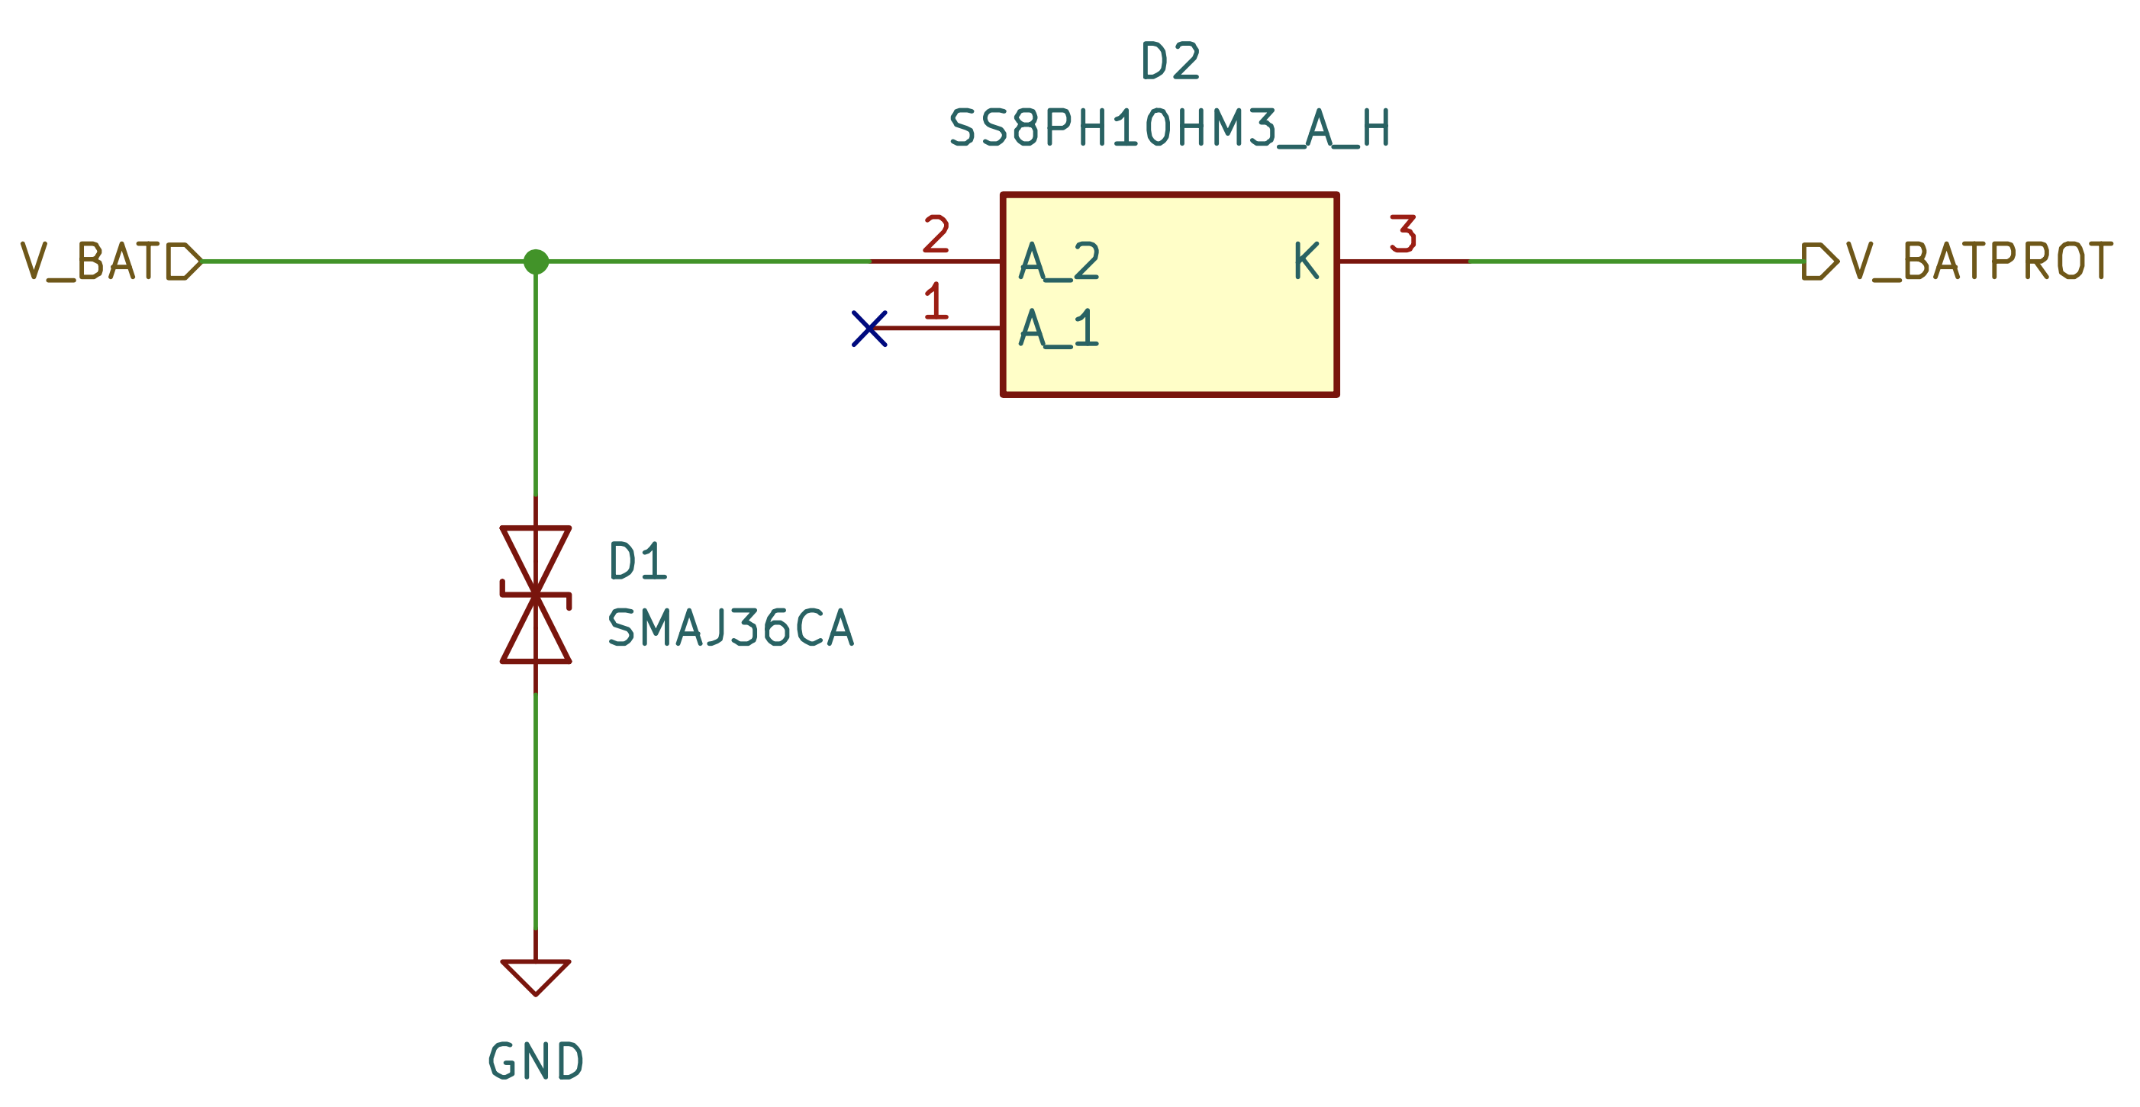
Circuit Schematics: Voltage Protection
Voltage Protection
Notes:
This is our voltage protection circuit. We used a Schottky diode for reverse polarity protection and a TVS diode to prevent voltage spikes.

Slide 14
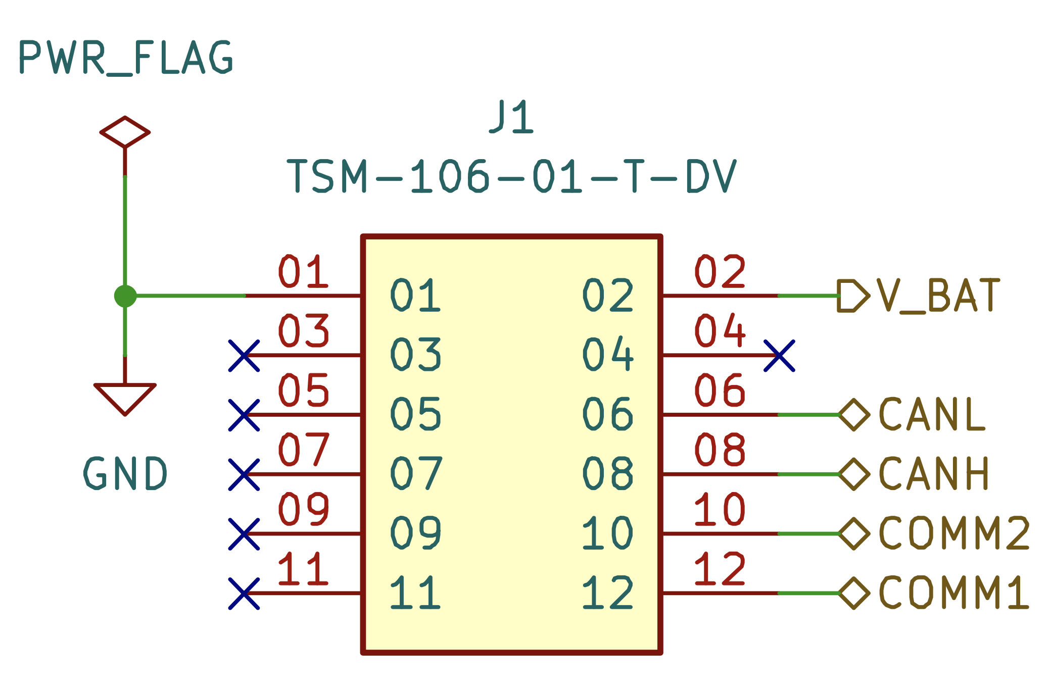
Circuit Schematics: Connector
TSM-106-01-T-DV
Notes:
And lastly, this pin header connector is the interface between our PCB and external systems.

Slide 15
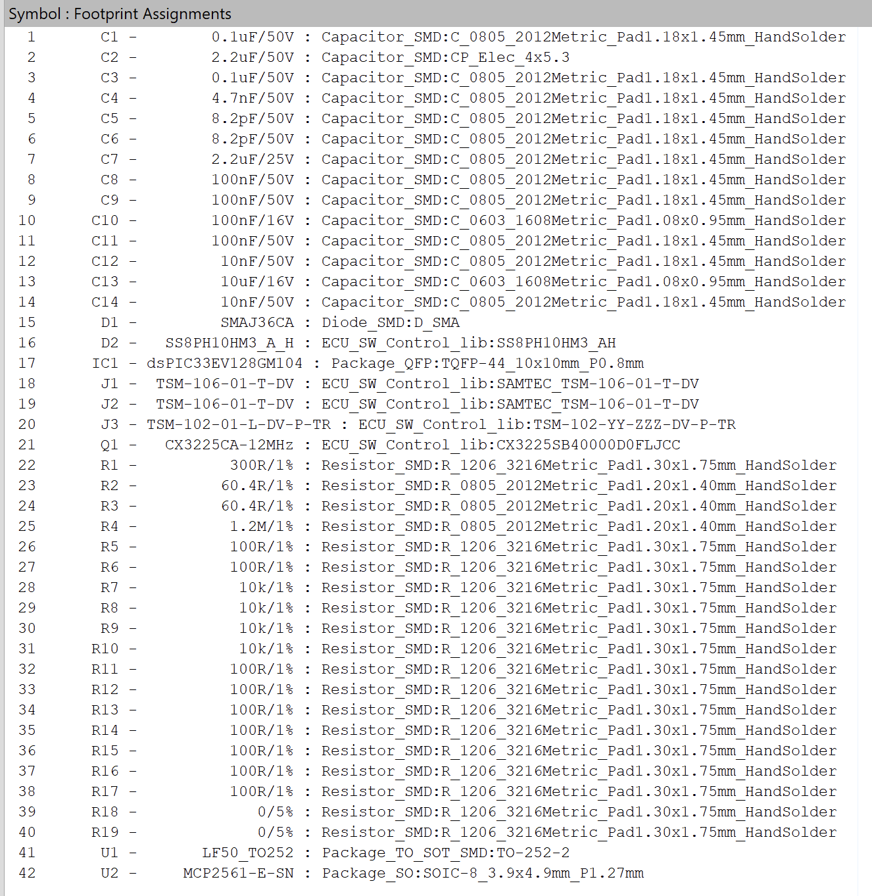
Footprint Capture
Notes:
After completing the circuit schematics, we assigned accurate footprints to each component. This step ensures that all physical dimensions, pin mappings, and pad sizes are properly matched before PCB layout.

Slide 16
PCB Layout Design
Notes:
Then we moved on to PCB layout design. We kept the UART and CAN traces short and direct to reduce noise. Also, CAN traces have 120-ohm impedance to prevent signal delay. Decoupling capacitors were located near the power pins for stability.
This PCB has 4-layers. The first and fourth layers are signal layers. Components communicate with each other in these layers. The second layer is the ground layer. There is only one copper plate in this layer. The third layer is the power layer. This 4-layered approach provides better signal integrity and protects our circuit from noise and electromagnetic interference. Also, extra layers help heat distribution.

Slide 17
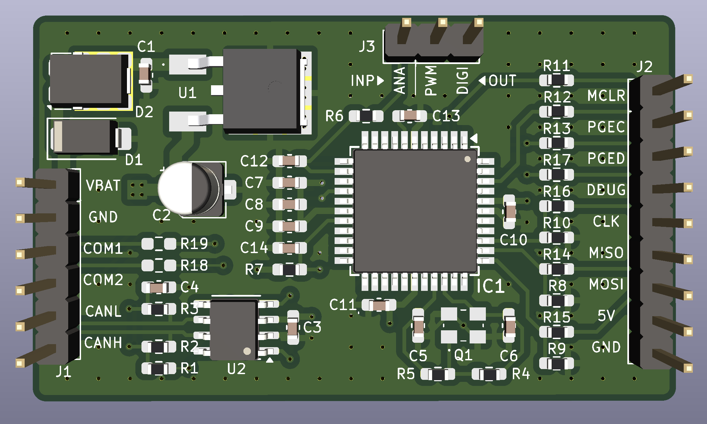
3D PCB Layout
Notes:
As you can see in the Figure, this is the 3D view of our PCB. We named each connector pin, which was very helpful in later stages.

Slide 18
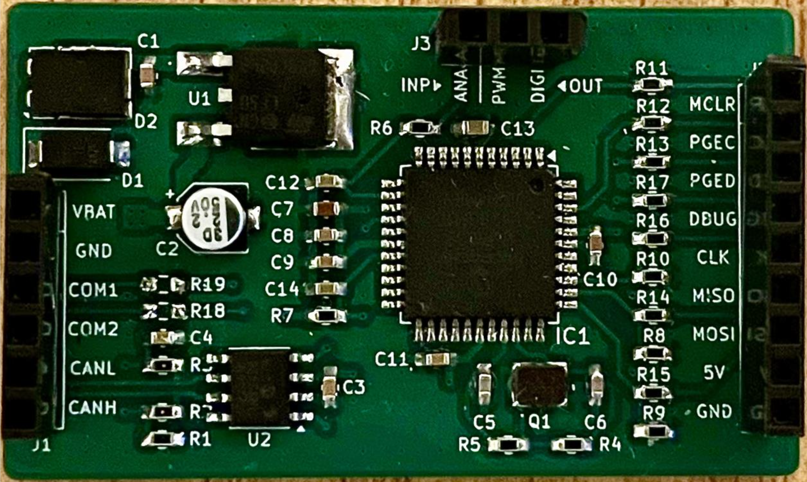
Manufactured PCB
Notes:
And this is the manufactured PCB. It is quite similar to the 3D view. İsmail will explain the software development section.

Slide 19
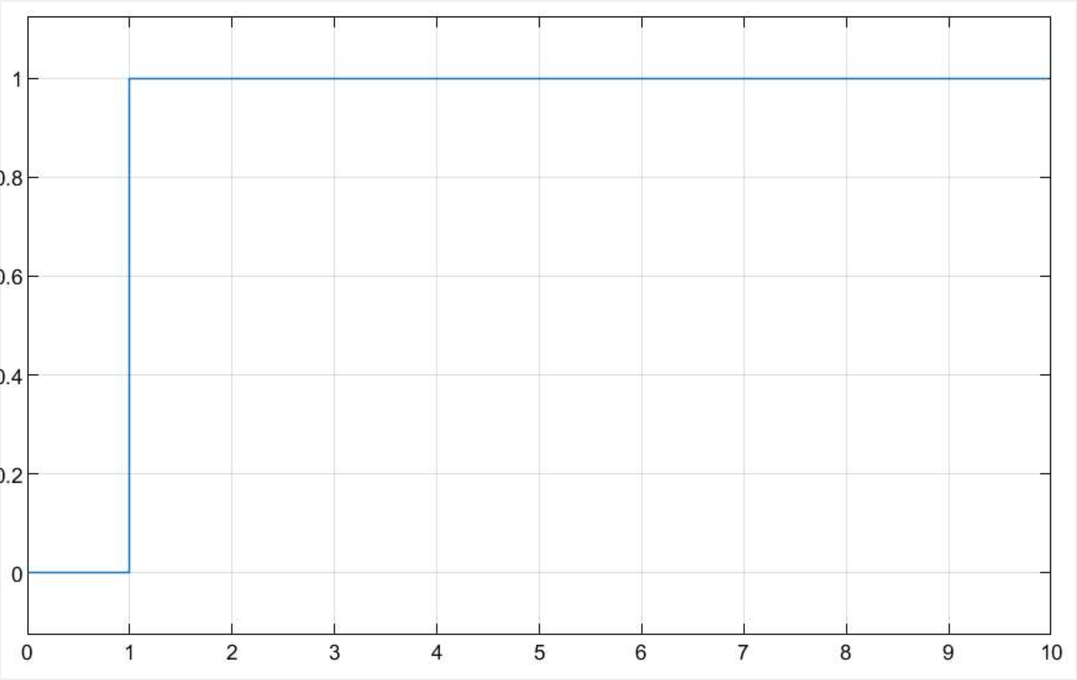
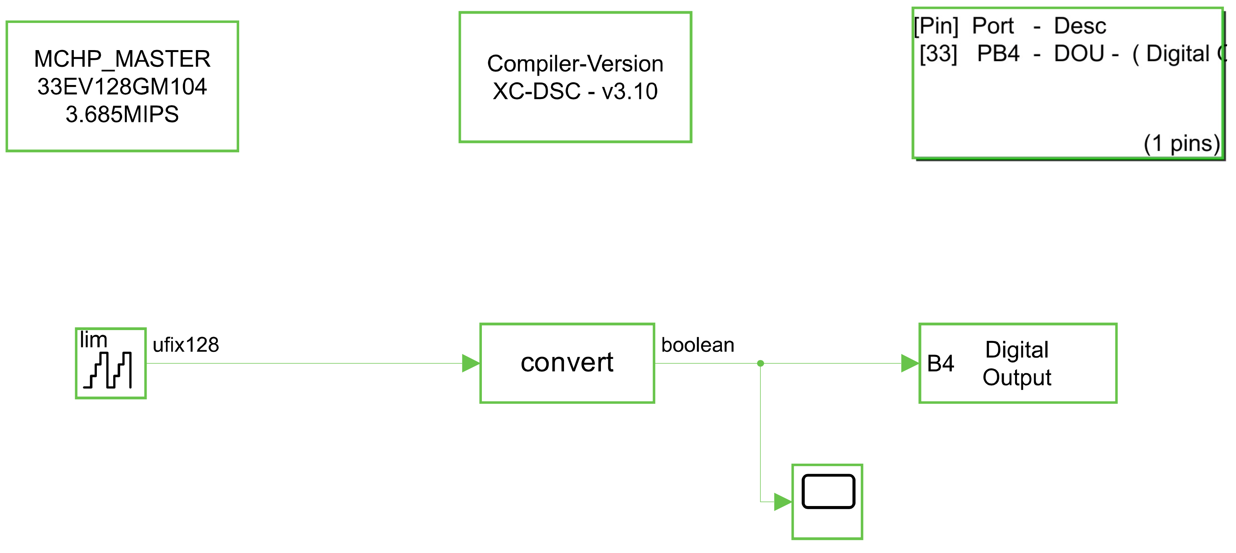
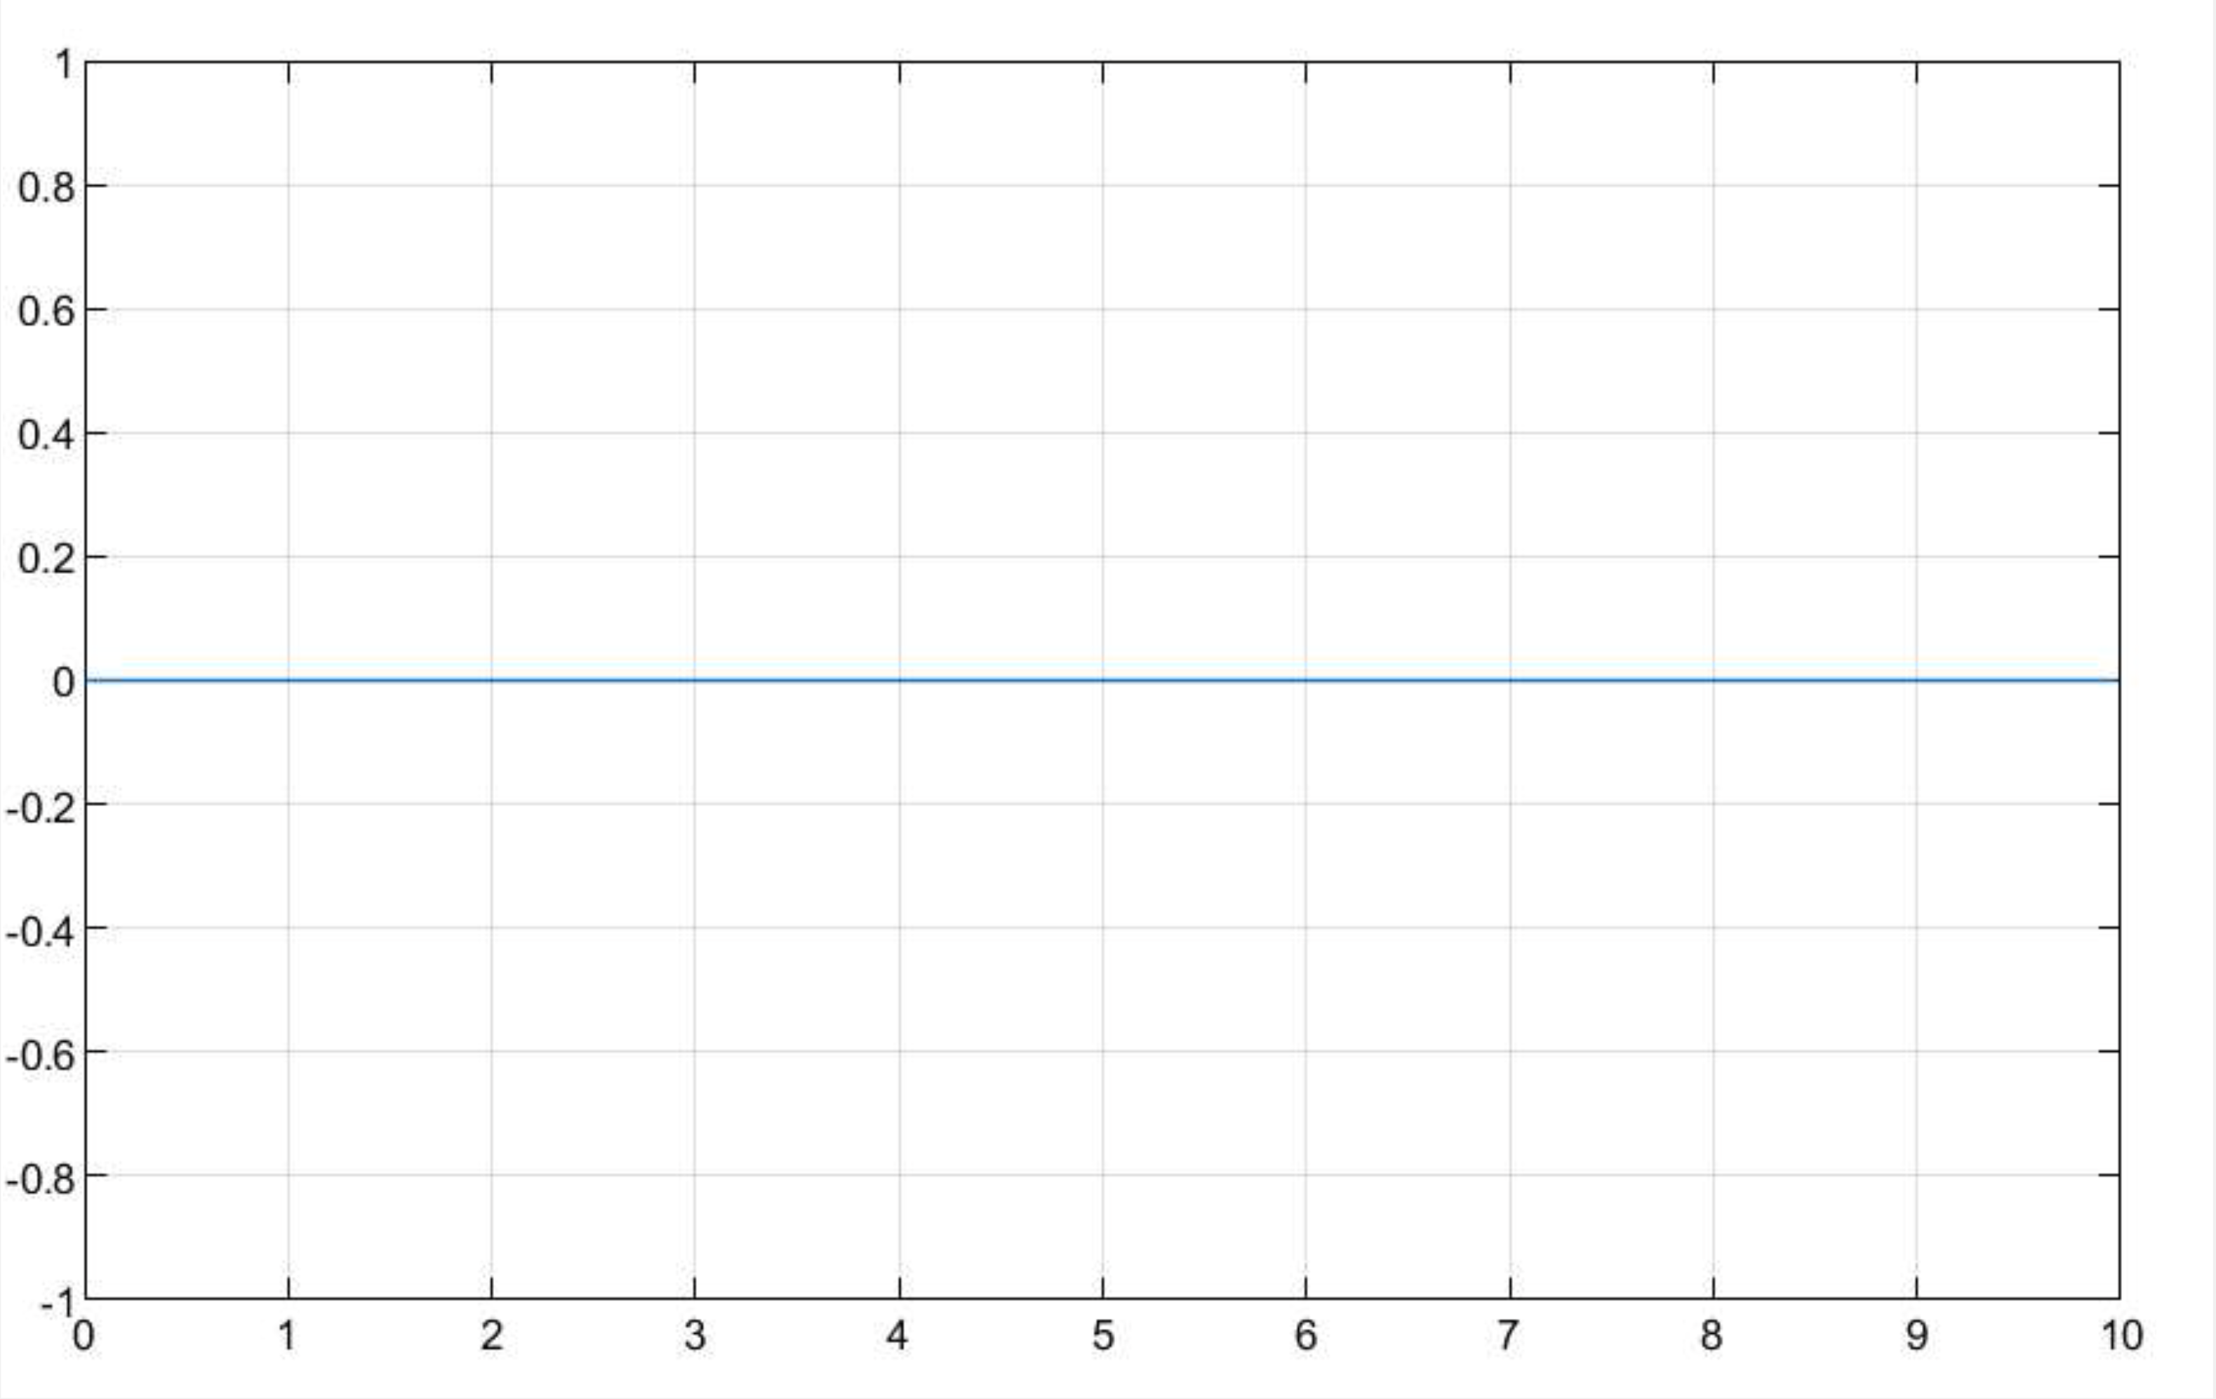
Simulink Model
HIGH (5V)
Digital Output Pin HIGH/LOW
LOW (0V)

Slide 20
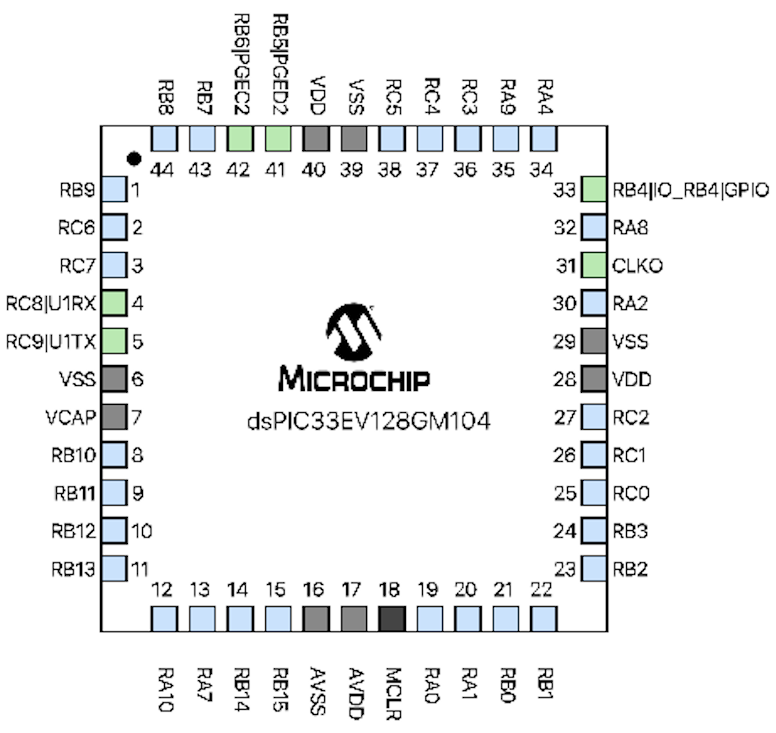



UART Communication
Peripheral Configuration
Parity: None
Data Bits: 8
Stop Bits: 1
Baud Rate Calculation
Notes:
“For serial communication between the ECU and external devices, we used the UART1 module of the dsPIC33EV128GM104. The peripheral was configured as 8 data bits, no parity, and 1 stop bit—commonly known as 8N1. On the right, you can see the formula we used to calculate the baud rate setting. With a clock frequency of 3.685 MHz and a target baud rate of 9600, the U1BRG register is set to approximately 23 to achieve accurate timing.”

Slide 21
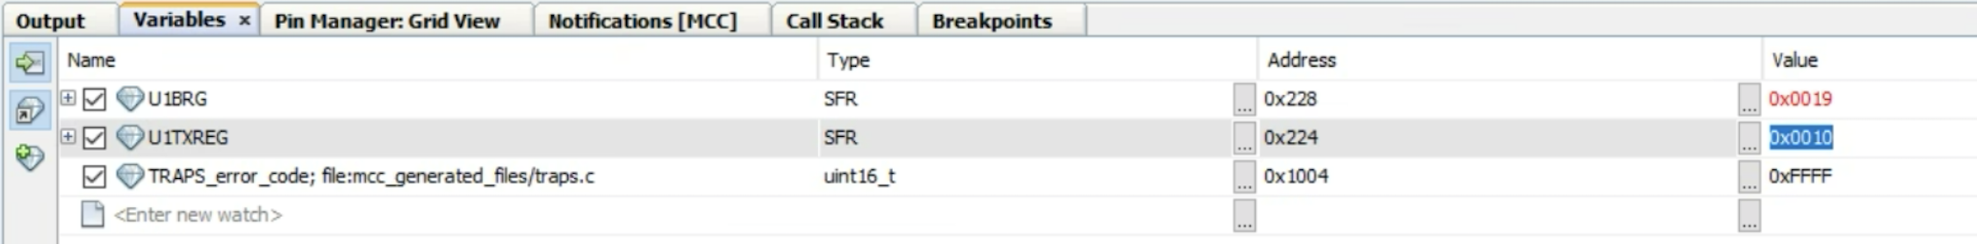
UART Communication
Verification of Transmission Functionality
A simple test routine was implemented to continuously transmit the ASCII character “a” every 100 milliseconds using UART.
This test confirmed that U1TXREG was being updated correctly.
The character was successfully received at Tera Term or Terminal at 9600 baud.

Slide 22
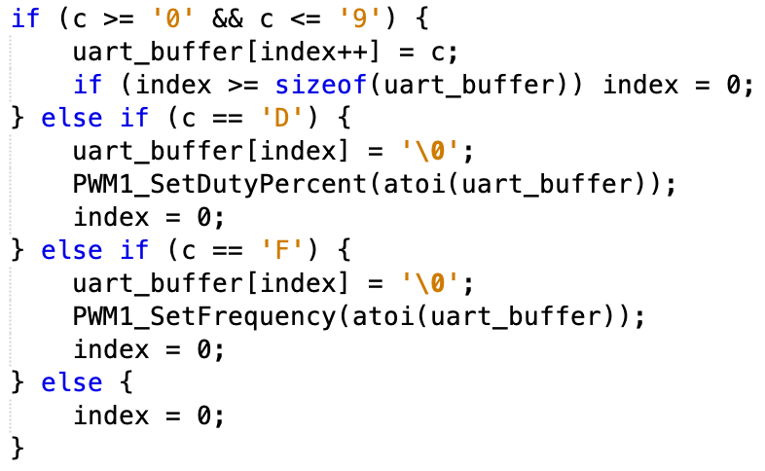


UART Communication
Real-time PWM Signal Modulation
Notes:
“In this part of the project, we used UART to control the PWM signal parameters in real time. The left side shows how we calculate the PWM period and duty cycle based on the desired frequency and percentage. The right side shows our UART command parser. If the character ‘D’ is received, the buffer is interpreted as a duty cycle value. If ‘F’ is received, it updates the frequency. This way, we can dynamically change PWM settings from a GUI or serial terminal without resetting the system.”

Slide 23
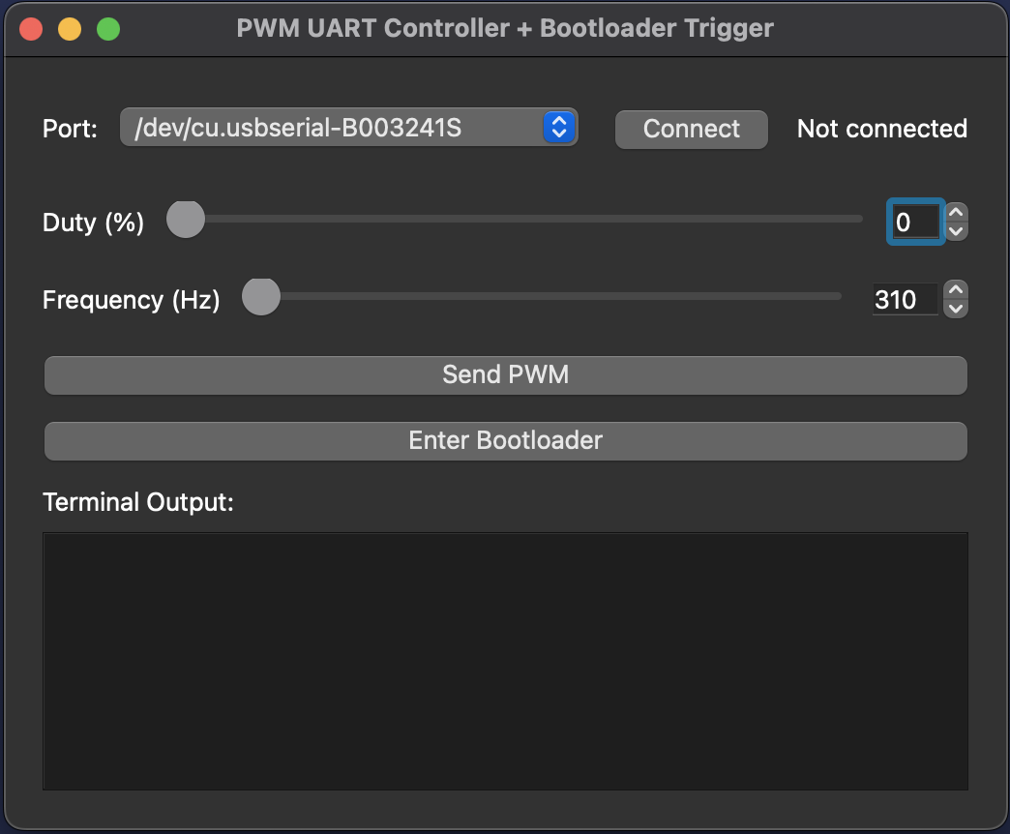
UART Communication
Integration of GUI

Slide 24
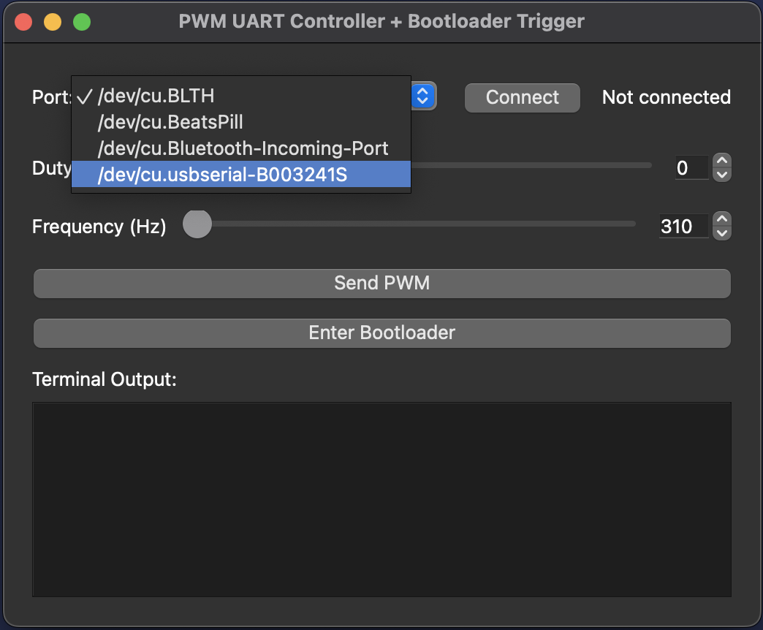
UART Communication
Integration of GUI

Slide 25
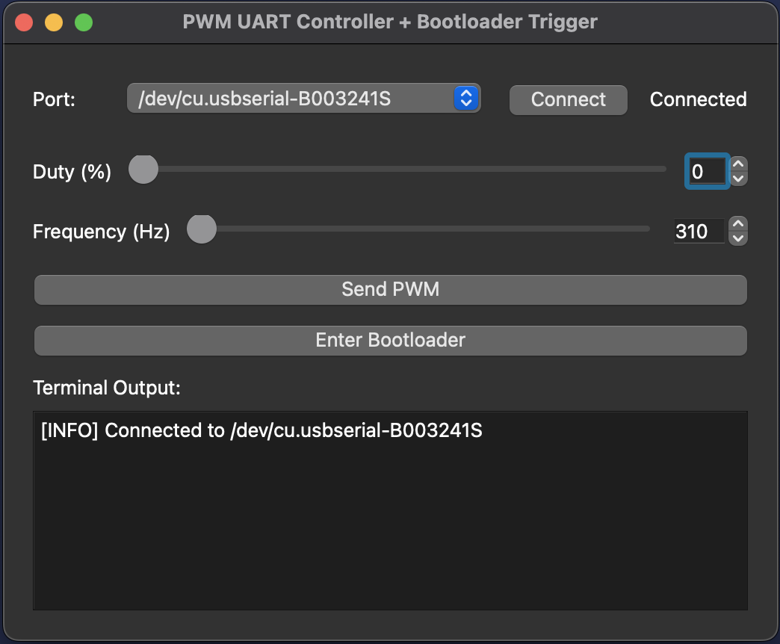
UART Communication
Integration of GUI

Slide 26
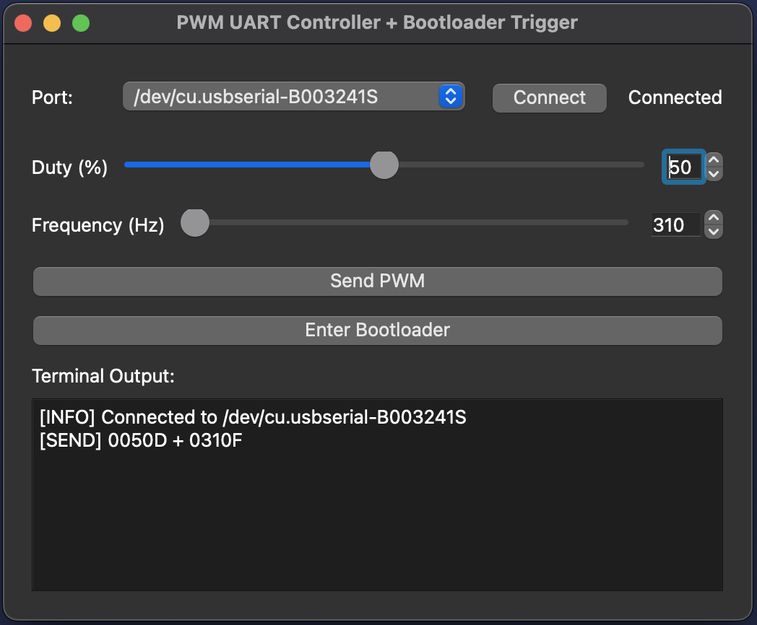
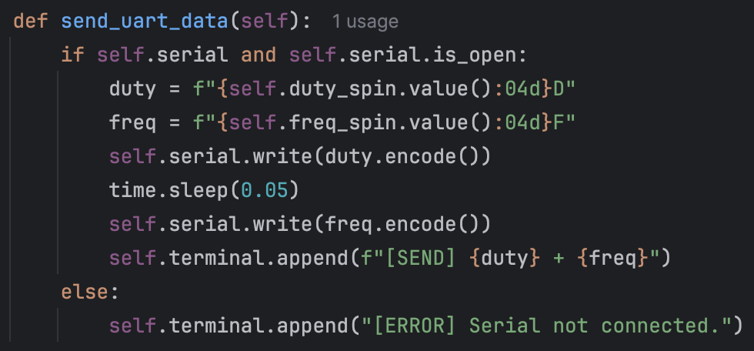
UART Communication
Integration of GUI

Slide 27
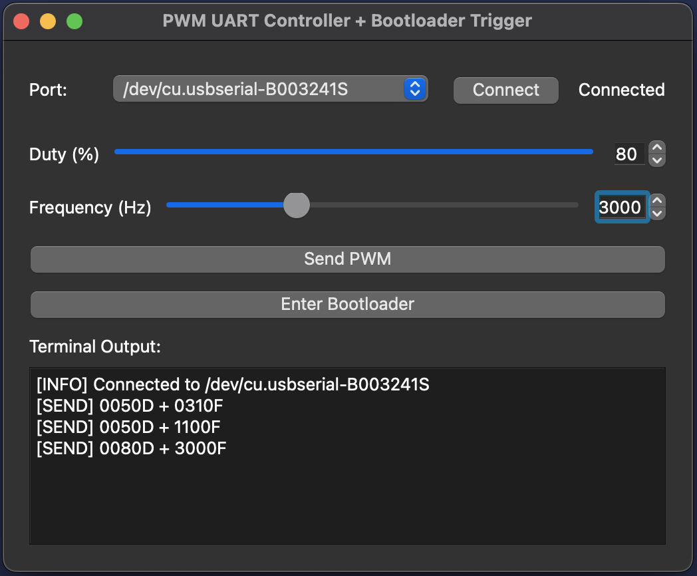
UART Communication
Integration of GUI

Slide 28
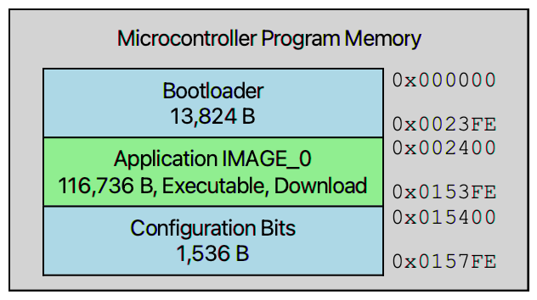
Bootloader Implementation
Architecture and Purpose
Perform secure firmware updates via UART
Operate independently from external programmers (PICkit)
Handle memory integrity and recovery
Enable runtime application switch-over after successful flashing
Notes:
A bootloader is a software component that runs before the main application to load new firmware into memory.
In our design, it securely updates firmware via UART communication.
It works without external programmers like PICkit.
It also ensures memory integrity.
As shown, it starts from address 0x0000 to 0x2400.

Slide 29
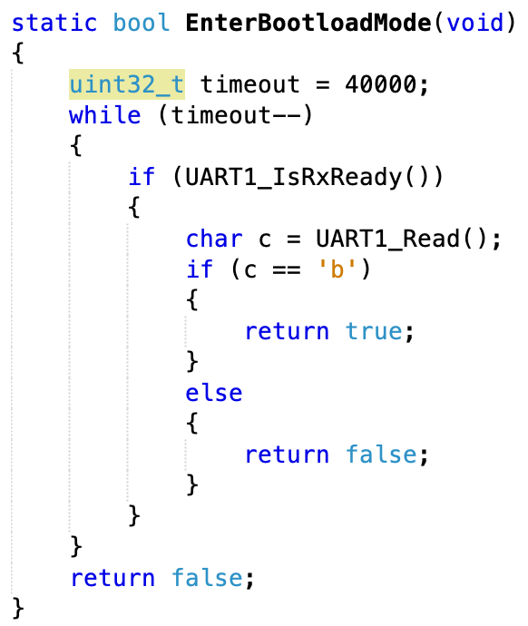
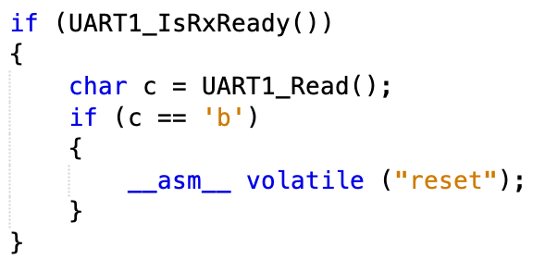
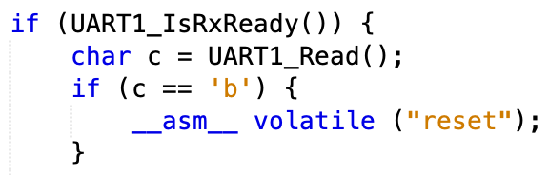
Bootloader Implementation
UART Controlled Entry Mechanism
Notes:
To trigger the bootloader, we implemented a UART-controlled entry mechanism.
At start, the microcontroller waits for a short period and listens for the character 'b' via UART.
If character ‘b’ is received, the microcontroller enters bootloader mode. Otherwise, it runs the main application.

Slide 30
Bootloader Implementation
GUI Based Control and UBHA
Notes:
We also add an enterbootloader button to our GUI.
Now it allows users to set PWM values and also enter bootloader mode by clicking a single button.
The GUI automatically detects available ports and provides real-time feedback, as İsmail mentioned.

Slide 31
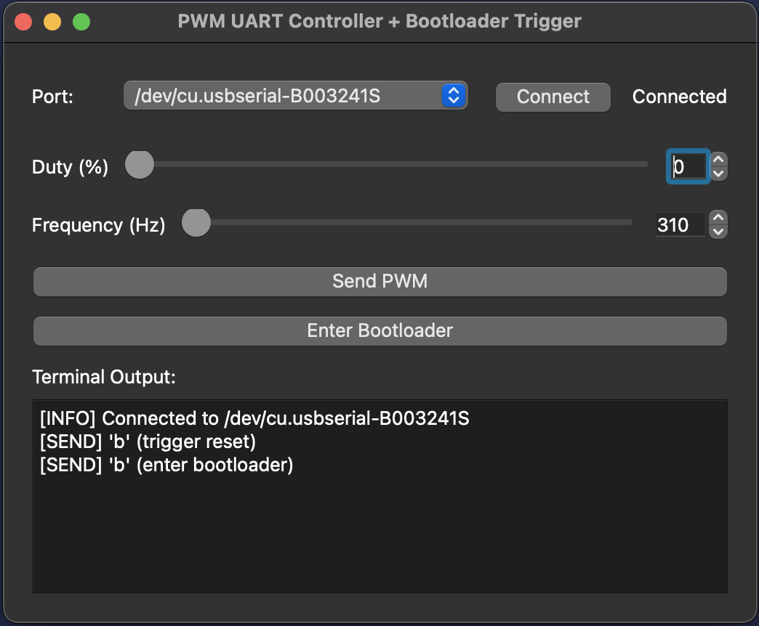
Bootloader Implementation
GUI Based Control and UBHA
Notes:
When the user clicks the ‘Enter Bootloader’ button, the GUI first sends a 'b' character to stop the currently running application.
Then it sends another 'b' after reset to trigger bootloader mode on the microcontroller.
As shown in the terminal output, both commands are sent successfully over the UART.

Slide 32
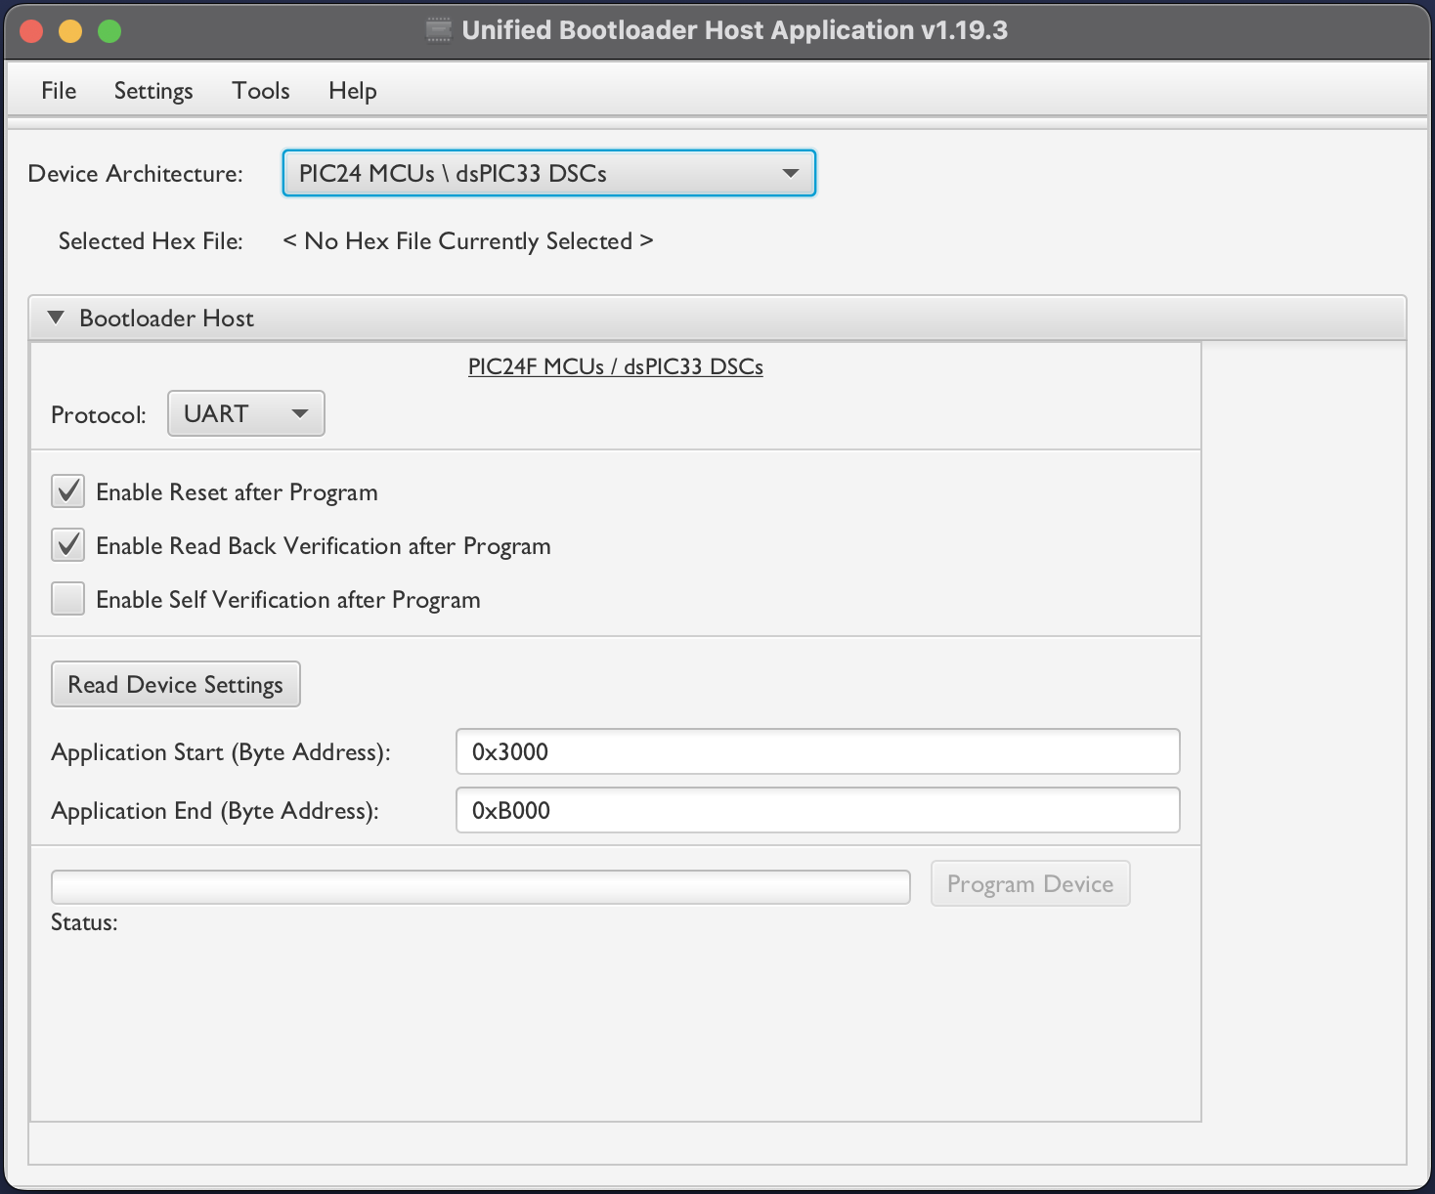
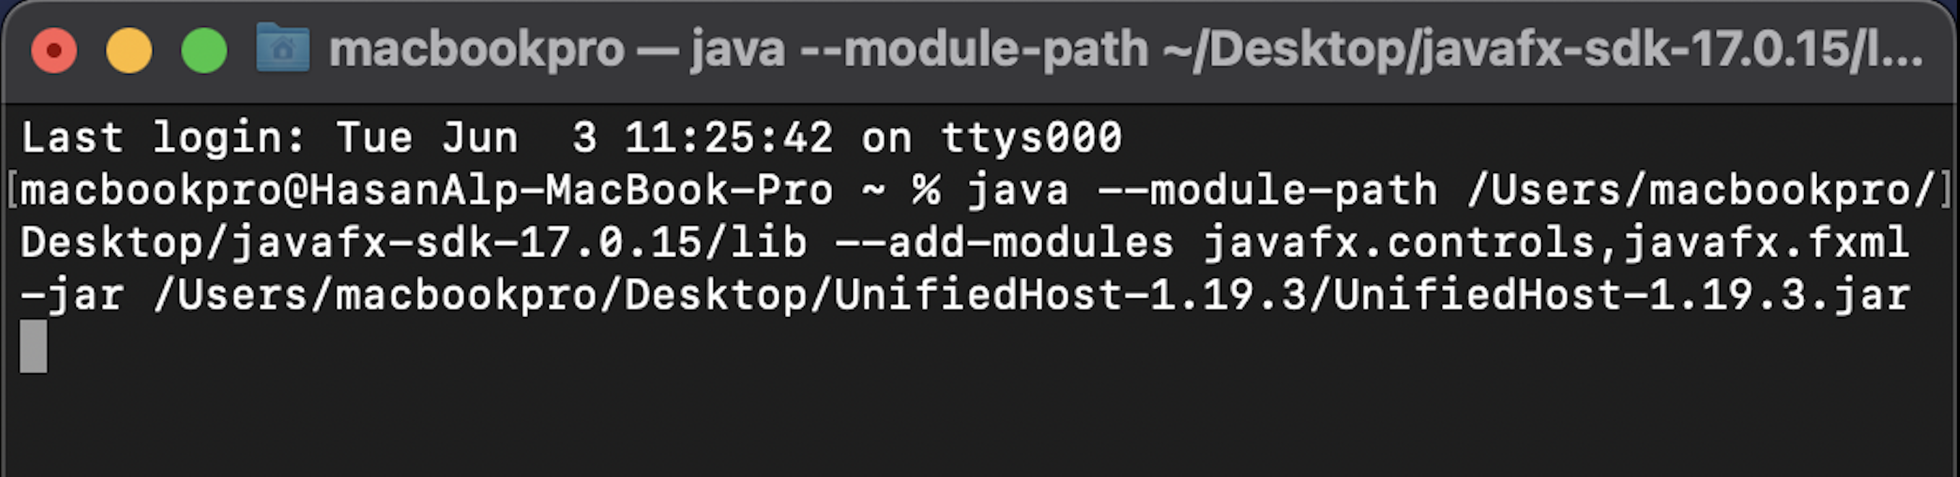
Bootloader Implementation
GUI Based Control and UBHA
Notes:
After entering bootloader mode, we used Microchip’s Unified Bootloader Host Application to upload the new firmware.
As shown in the Figure, first you should choose your microcontroller type.

Slide 33
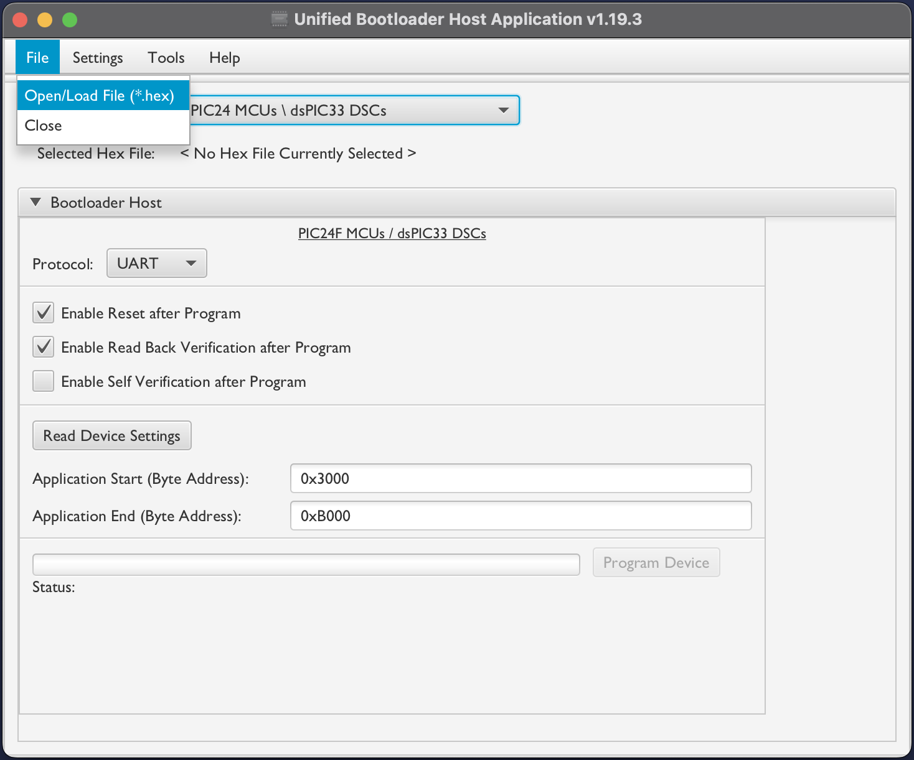
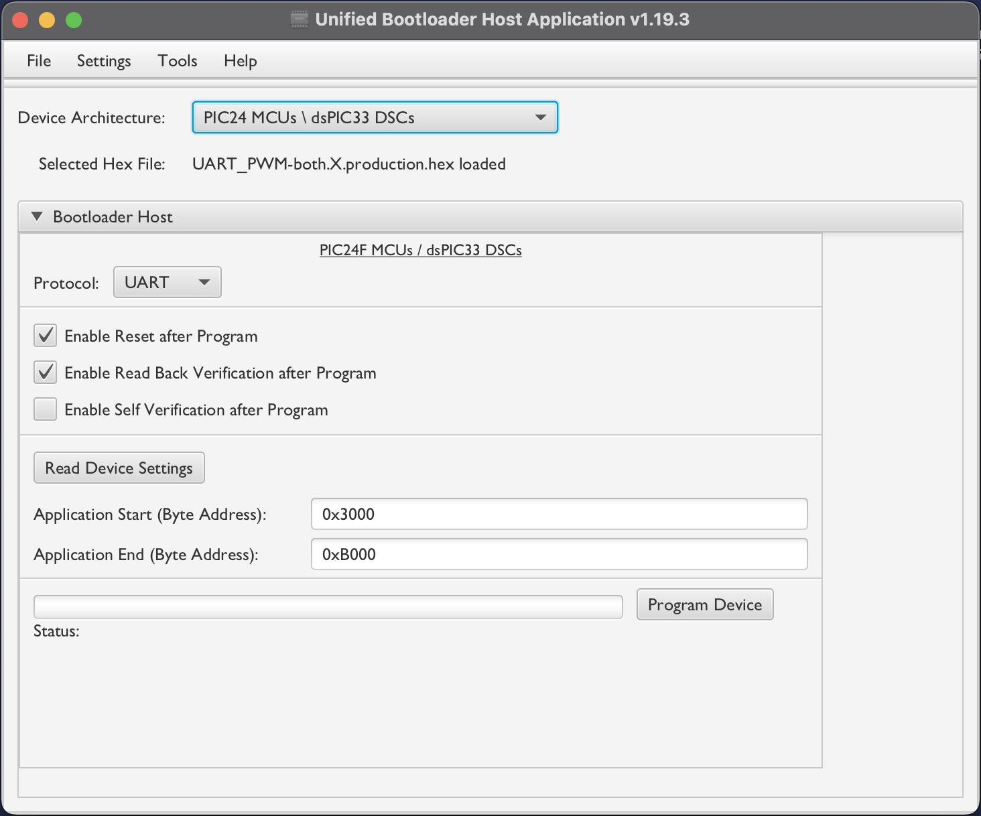
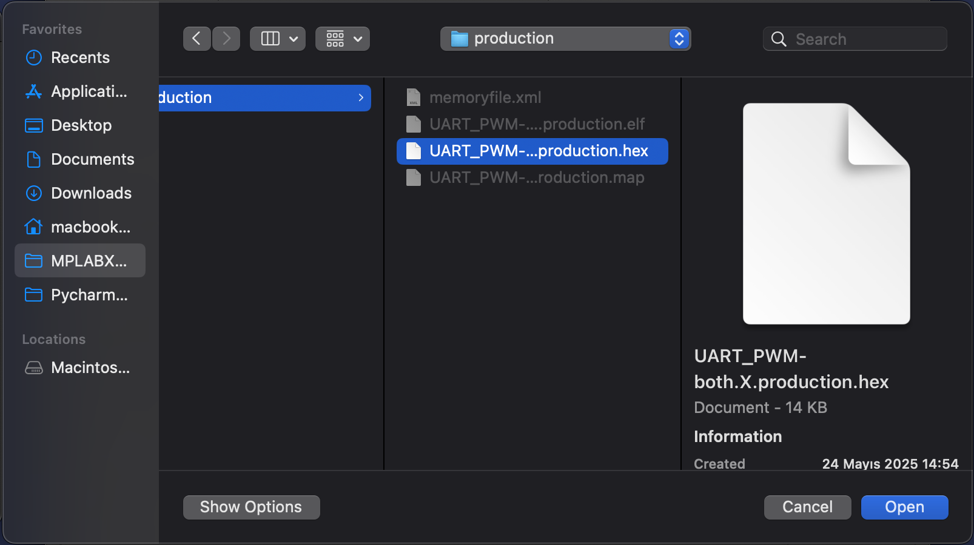
Bootloader Implementation
Notes:
Then, we load the application’s HEX file into the UBHA interface.
On the left, you can see the file selection window.
After selection, as shown on the right, the file is ready to be programmed into the microcontroller’s memory.

Slide 34
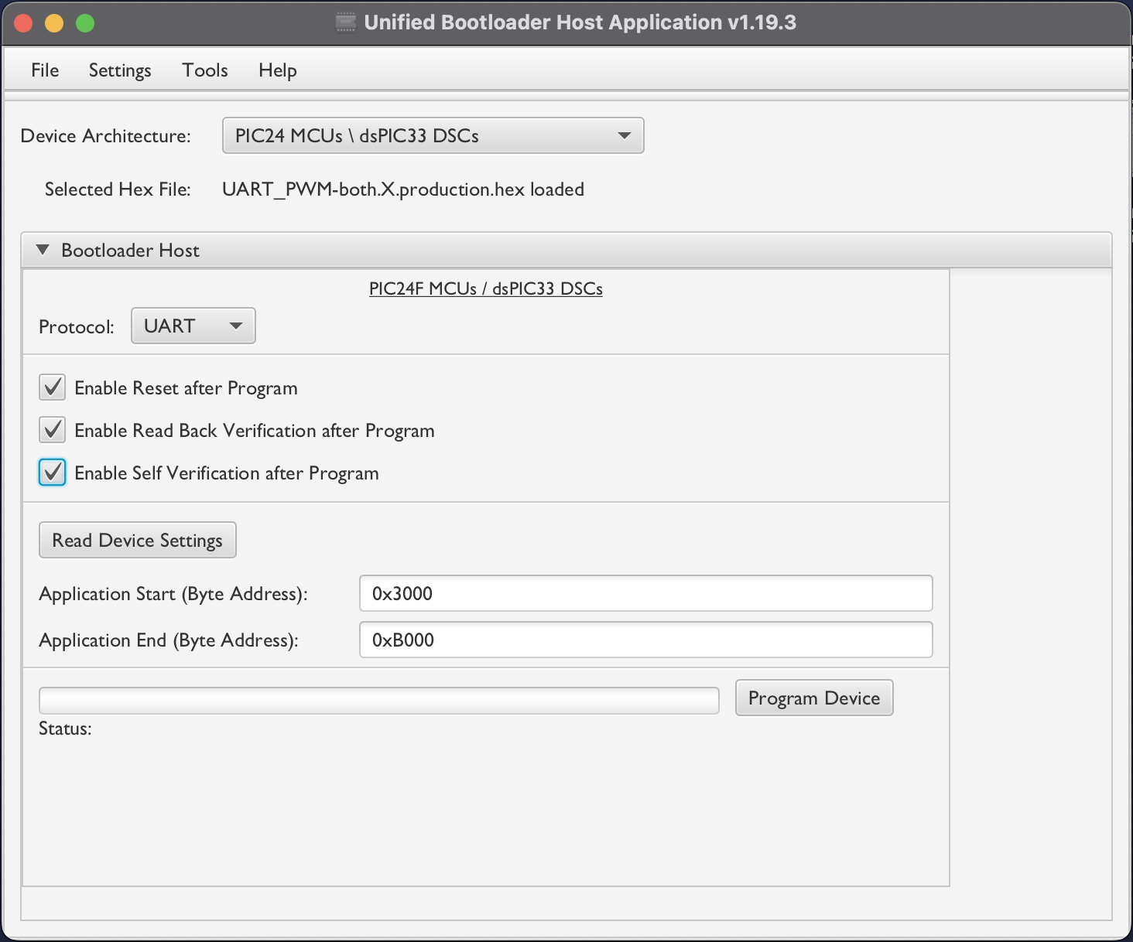
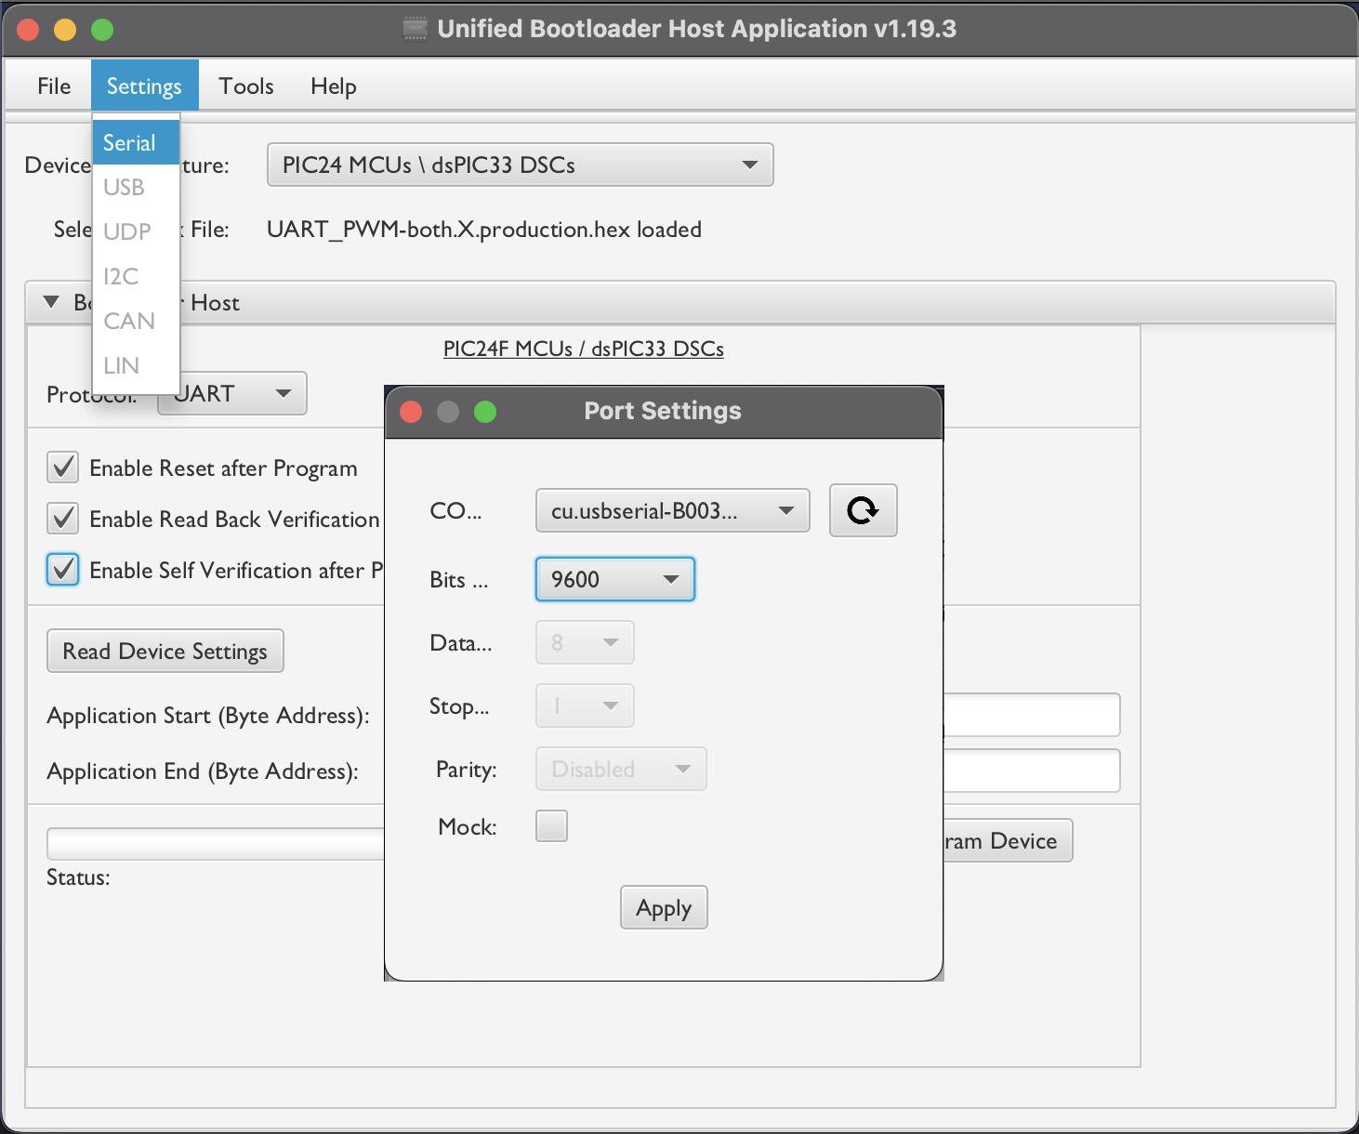
Bootloader Implementation
Notes:
But before starting the programming process, we need to configure the correct communication settings.
As shown here, the protocol is set to serial, and the baud rate is manually adjusted.
These settings must be similar to the microcontroller’s bootloader configuration to ensure a successful connection and data transfer.

Slide 35
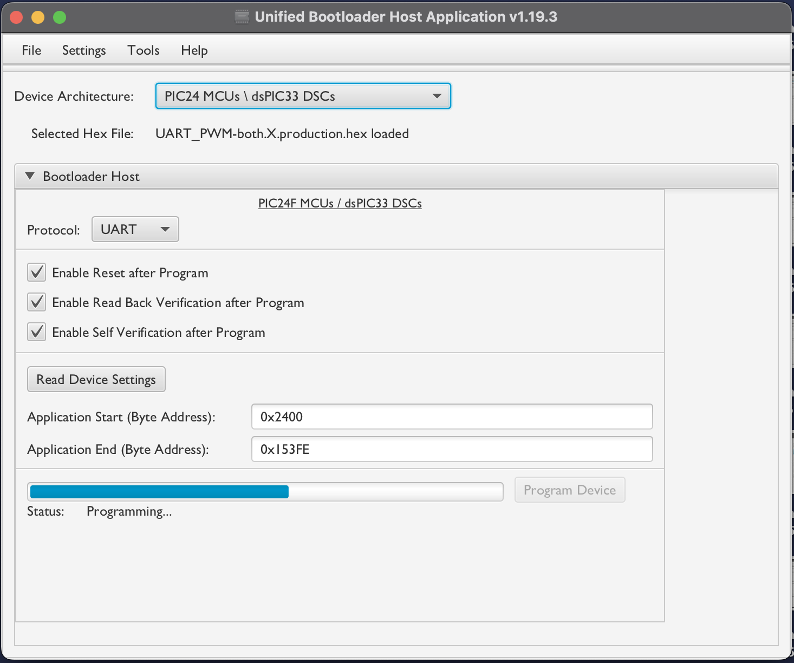
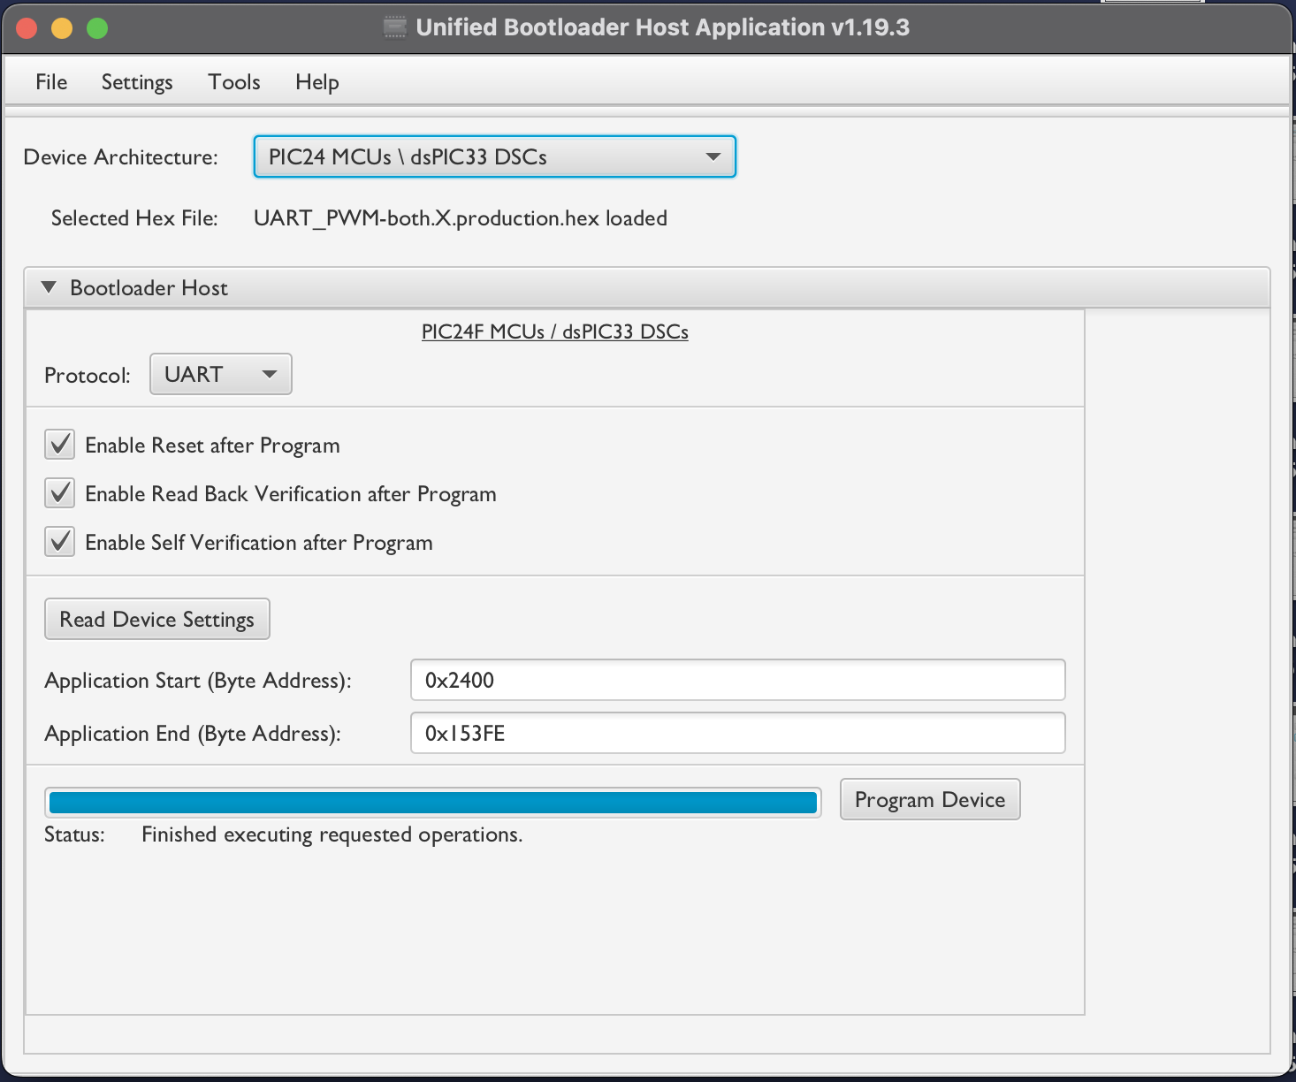
Bootloader Implementation
Notes:
You can see the programming process. On the left, the HEX file is being written to memory.
On the right, the operation has completed successfully.

Slide 36

Bootloader Implementation
Security Methods
Checksum
A simple method that sums up data bytes.
Fast and lightweight, but limited in detecting complex errors.
CRC-32
More robust than checksum.
Detects bit-flips, burst errors, and even intentional alterations.
Used during both transmission and verification stages.
Notes:
Also, we implemented two security methods to ensure data integrity.
The first one is Checksum, which simply adds up all data bytes. It’s fast, but limited in detecting complex errors.
So we also use CRC-32, which is more reliable and it can detect bit-flips, burst errors, and even intentional modifications.
CRC is applied during both transmission and verification, and if a mismatch is found, the bootloader automatically rejects the block and requests retransmission.

Slide 37
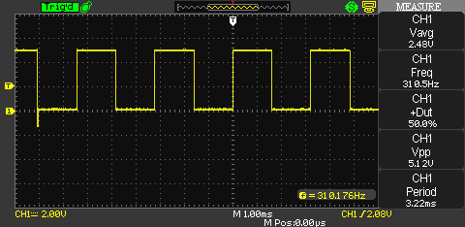
Results and Discussions
PWM Frequency and Duty Cycle

Slide 38
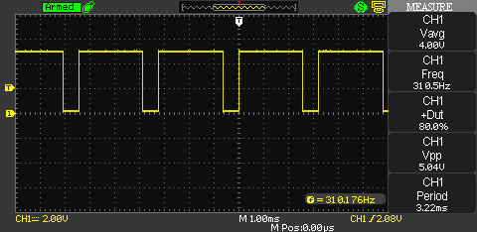
Results and Discussions
PWM Frequency and Duty Cycle

Slide 39
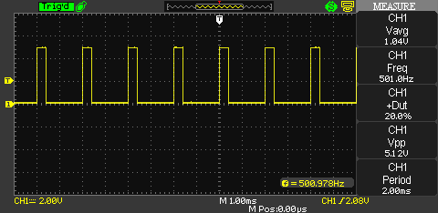
Results and Discussions
PWM Frequency and Duty Cycle

Slide 40
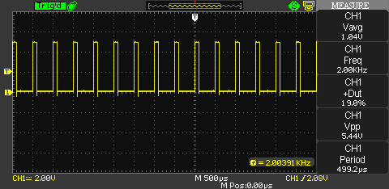
Results and Discussions
PWM Frequency and Duty Cycle

Slide 41
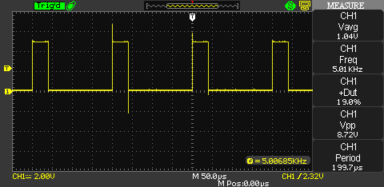
Results and Discussions
PWM Frequency and Duty Cycle

Slide 42
Results and Discussions
Digital Output Pin

Slide 43
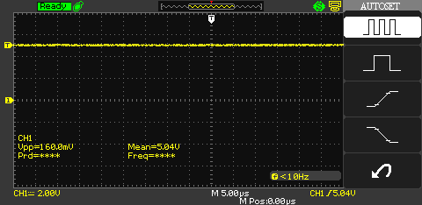
Results and Discussions
Digital Output Pin

Slide 44
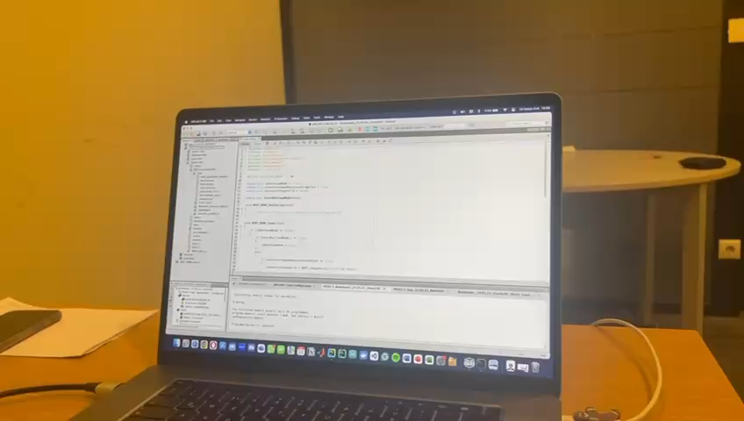
Results and Discussions

Slide 45
Conclusion
Project Achievements
A 4-layer PCB is designed, including a microcontroller, CAN transceiver, LDO, and a voltage protection circuit.
A bootloader is developed for secure firmware updates via UART.
A test software is implemented for real-time PWM control via UART.
A Python-based GUI is developed for changing PWM features and entering bootloader mode.
UBHA is used for programming the microcontroller.

Slide 46
References
[1] Z. Ji, Z. Xiangyu, and P. Yong, “Implementation and research of bootloader for automobile ecu remote incremental update,” 01 2015.
[2] M. Conrad, S. Sadeghipour, and H.-W. Wiesbrock, “Automatic evaluation of ecu software tests,” SAE Transactions, vol. 114, pp. 583–592, 2005. [Online]. Available: http://www.jstor.org/stable/44682468
[3] Y. Kang, J. Chen, and B. Li, “Generic bootloader architecture based on automatic update mechanism,” in 2018 IEEE 3rd International Conference on Signal and Image Processing (ICSIP). IEEE, 2018, pp. 586–590.
[4] E. G. Leaphart, S. E. Muldoon, and J. N. Irlbeck, “Application of robust engineering methods to improve ecu software testing,” SAE Transactions, pp. 1007–1018, 2006.
[5] D.Bogdan,R.Bogdan,andM.Popa,“Designandimplementationofabootloaderinthecontext of intelligent vehicle systems,” in 2017 IEEE Conference on Technologies for Sustainability (SusTech). IEEE, 2017, pp. 1–5.
[6] J. Van den Herrewegen, “Automotive firmware extraction and analysis techniques,” Ph.D. dissertation, University of Birmingham, 2021.
[7] J. Zhang, Y. Lv, and Z. Liao, “Research on automotive ecu remote update and it’s security,” in Journal of Physics: Conference Series, vol. 1074, no. 1. IOP Publishing, 2018, p. 012133.
[8] STMicroelectronics, LFXX: Very low drop voltage regulator with inhibit function, 2017, https://www.st.com/resource/en/datasheet/lfxx.pdf.
[9] Microchip Technology Inc., MCP2561 High-Speed CAN Transceiver, 2013, https: //ww1.microchip.com/downloads/aemDocuments/documents/OTH/ProductDocuments/ DataSheets/20005167C.pdf.
[10] Microchip Inc., dsPIC33EVXXXGM00X/10X Family Data Sheet, 2024, available: https: //ww1.microchip.com/downloads/aemDocuments/documents/OTH/ProductDocuments/ DataSheets/dsPIC33EVXXXGM00X-10X-Family-Data-Sheet-DS70005144H.pdf.
[11] Littlefuse, SMAJ Series, 2022, https://www.littelfuse.com/assetdocs/ tvs-diodes-smaj-datasheet?assetguid=13c2a823-03b8-4d1f-9ddc-9b44670aed9d.
[12] Vishay, SS8PH9, SS8PH10: High Current Density Surface-Mount High Voltage Schottky Rectifier, 2020, https://www.vishay.com/docs/88989/ss8ph10.pdf.
[13] S. Inc., TSM-1XX-XX-XXX-XX-X-XXX-X, 2024, https://suddendocs.samtec.com/prints/ tsm-1xx-xx-xxx-xx-x-xxx-x-mkt.pdf.

